Slide 1
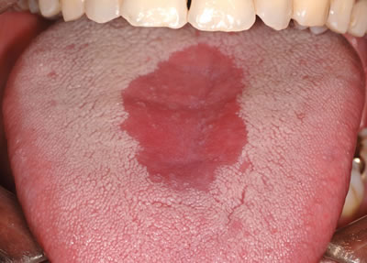
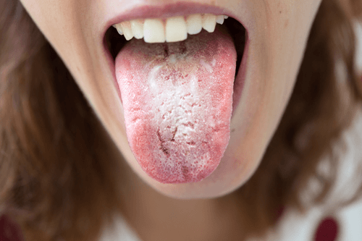
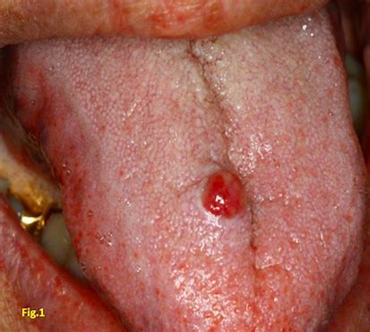
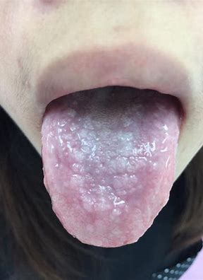
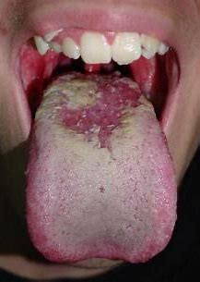
Designing a Hands-On Oral Cancer Diagnosis Training Model of the Tongue
Abby Dowse (agd7@rice.edu), Brandon Chen (bac10@rice.edu) & Lily Didcock (lgd1@rice.edu)
The Problem
Prototyping
Feedback and Results
Low 5-year survival ${\text{rate}}^{1}$
if diagnosed in late stages, < 20%
if diagnosed in early stages, > 80%
Only diagnosed early 29% of the ${\text{time}}^{2}$
Oral cancer is diagnosed in three main ${\text{ways}}^{3}$
Palpation (texture)
White Light
Fluorescent Light (tongue, not lesions, fluoresce)
Current training methods for clinicians and students (written resources and images) are insufficient
Do not provide hands-on experience
The Tongue
Erythroplakia
Leukoplakia
Used weekly feedback to modify designs
Final models incorporate features we received positive feedback on:
Dragon skin material deemed good model of skin texture
“Noticeable firmness” created by additional dragon skin on top of tongue
Felt inside tongue created “realistic ulcerated lesion”
Tongue “fluoresces well”
Made out of Dragon Skin using single base mold
Colored using pigments mixed into dragon skin
Fluoresces due to mixed-in fluorescent paint
Goal: Soft and velvety;
fiery red, sometimes white spots
Goal: Firm, rough, slightly raised; white, sometimes red spots
Fluorescent pic
Sample Evaluation Table
 | 1 | 2 | 3 | 4 | 5
Palpation | Tongue feels extremely unrealistic | Tongue feels unrealistic | Tongue feels somewhat realistic | Tongue feels fairly realistic | Tongue feels completely / very realistic
White Light | Tongue looks extremely unrealistic under white light | Tongue looks unrealistic under white light | Tongue looks somewhat realistic under white light | Tongue looks fairly realistic under white light | Tongue looks completely / very realistic under white light
Fluorescence | Tongue looks extremely unrealistic under fluorescence | Tongue looks unrealistic under fluorescence | Tongue looks somewhat realistic under fluorescence | Tongue looks fairly realistic under fluorescence | Tongue looks completely / very realistic under fluorescence
Our Tongue Under VELscope
Created palpation with embedded felt
Colored red with just pigment: visual realism w/o impacting palpation
Fluorescent paint in tongue, not lesion
Created palpation with embedded felt
Used white paint over top to create hardened texture, visual realism
Fluorescent paint in tongue, not lesion
Our Solution
Tongue Mold
True Tongue Under VELscope
Our model will give students and clinicians hands-on experience recognizing dangerous lesions, thus reducing oral cancer mortality
Found realistic ways to model common lesion types (4 precancerous + cancer itself)
Focused our prototyping on tongue – most common location of lesions
Created tongues using one base mold (plus molds for some individual lesions)
Used a small number of simple materials embedded in and attached to tongue to create realistic lesions
Future Development
Pyogenic Granuloma
Lichen Planus
Oral Cancer
Future iterations aim to:
Expand model to include entire oral cavity (buccal mucosa, gums, lips, hard palate, etc.)
Incorporate lesions into other location
Incorporate tongue into frame/cavity
Test under wider variety climate conditions
Test effectiveness of models with more clinical feedback and retention data
Goal: Lobular, elevated, spongy; bright/dark red or pink
Goal: Firm and rough; red center; lacy white with some red
Goal: Firm, indurated, rough, elevated mass; red and/or white
Design Criteria
Created lesion using separate mold
filled with dragon skin and embedded sponge for palpation
Fluorescent paint in tongue, not lesion
Used painted, embedded felt to create palpation
Painted felt red, then blotted white on top – lacy visual appearance
Fluorescent paint in tongue, not lesion
Created lesion using separate mold
filled with dragon skin
Painted top of lesion red and white for visual realism
Fluorescent paint in tongue, not lesion
Acknowledgements
Realistic with Palpation → lesion feels similar to true lesion of the same type
Realistic with Autofluorescence → lesion looks similar to true lesion under fluorescent light (lesion does not fluoresce but tongue does)
Realistic with White Light → lesion looks similar to true lesion under white light
Number of Lesions → can create a wide variety of lesions using design (goal: at least 5)
Low Cost → model is affordable (goal: < $200)
Thank you to Dr. Vigneswaran, Dr. Gillenwater, Dr. Schwarz, Dr. Richards-Kortum, Dr. Bond, Dr. Carns, Yajur Maker, Alex Kortum, Jackson Coole and Team OrCan.
References
Campion, A., C. Ribeiro, R. Luiz, F. Júnior, H. Barros, K. Santos, S. Ferreira, L. Gonçalves, and S. Ferreira. Low Survival Rates of Oral and Oropharyngeal Squamous Cell Carcinoma. International Journal of Dentistry: 2017.
Oral and Oropharyngeal Cancer: Statistics [Internet] 2020 [cited 22 February 2021]. Available from: <https://www.cancer.net/cancer-types/oral-and-oropharyngeal-cancer/statistics#:~:text=If%20the%20cancer%20is%20diagnosed,are%20diagnosed%20at%20this%20stage>
Sankaranarayanan, R., K. Ramadas, H. Amarasinghe, S. Subramanian, and N. Johnson. Oral Cancer: Prevention, Early Detection, and Treatment. Disease Control Priorities 3: 2015.
Testing Process
Clinical feedback vital in testing the realism of models
Every week, physical copies of tongue models delivered to mentors
Mentors filled out an evaluation rubric on how close models matched the actual condition
Palpation, white light, fluorescent realism
Modified designs based on feedback through an iterative design process
Attended weekly zoom meetings to receive oral feedback on models
Obtained VELscope – used to make sure lesions fluoresce, compared to images
College of
Arts & Sciences

