Slide 1
Aluminum Casting
April 12, 2014

Slide 2
Agenda
Overview of casting techniques
Blue foam mold build time
Aluminum pouring

Slide 3
What is metal casting?

Slide 4
What is metal casting?
Process of pouring molten metal into a pre-formed mold
Allows the creation of unique geometries with little machining
Applied correctly, it can greatly simplify the process of fabricating metal components

Slide 5
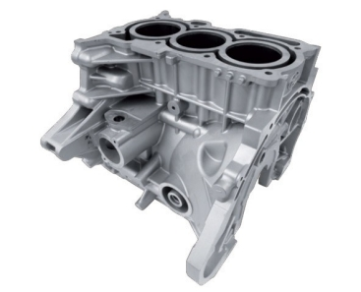
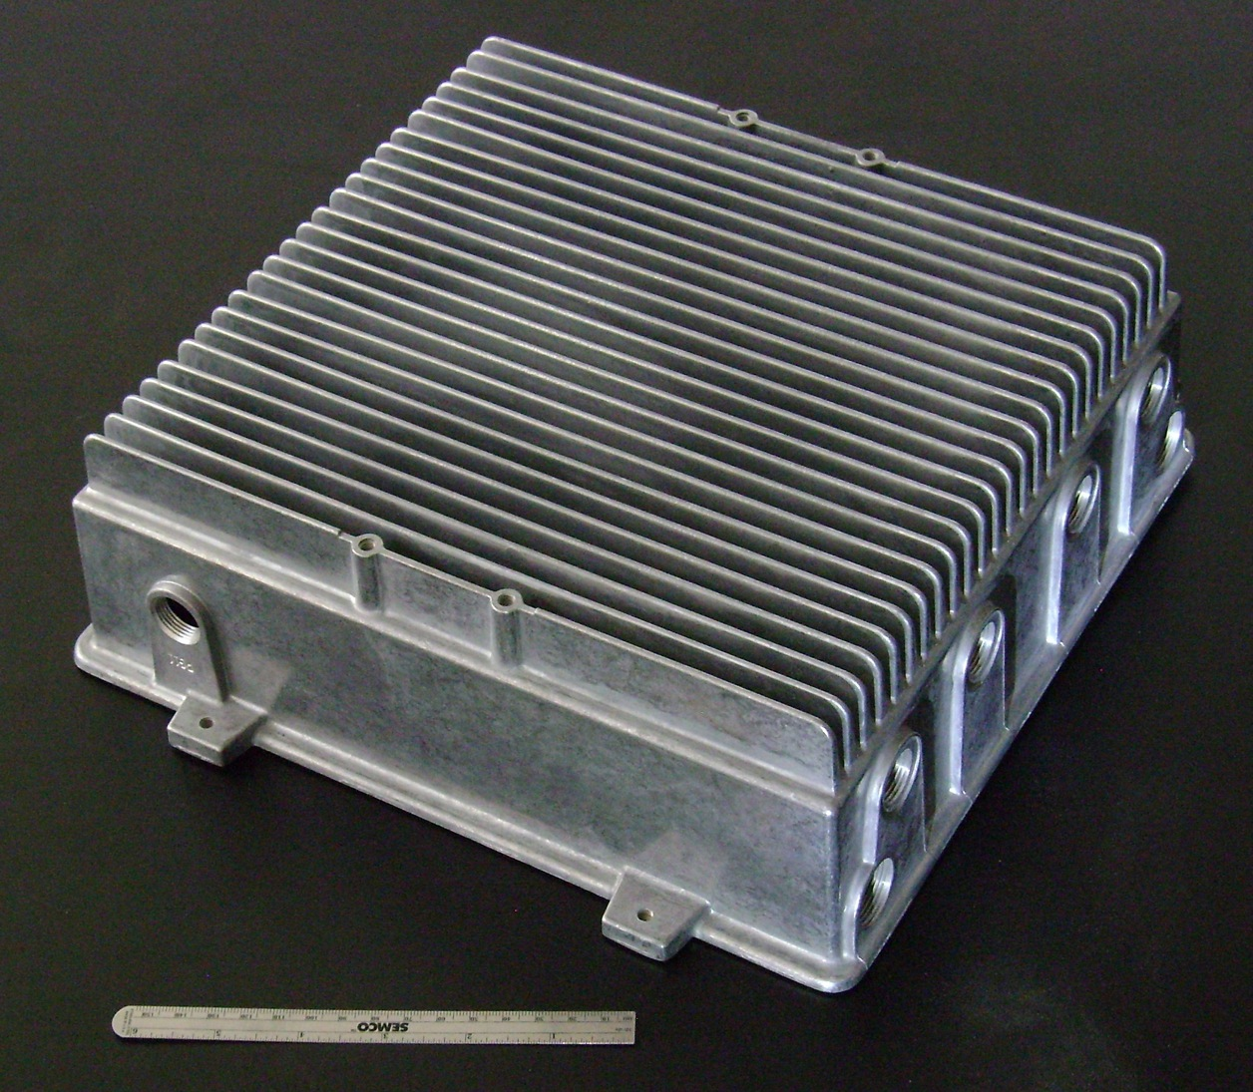
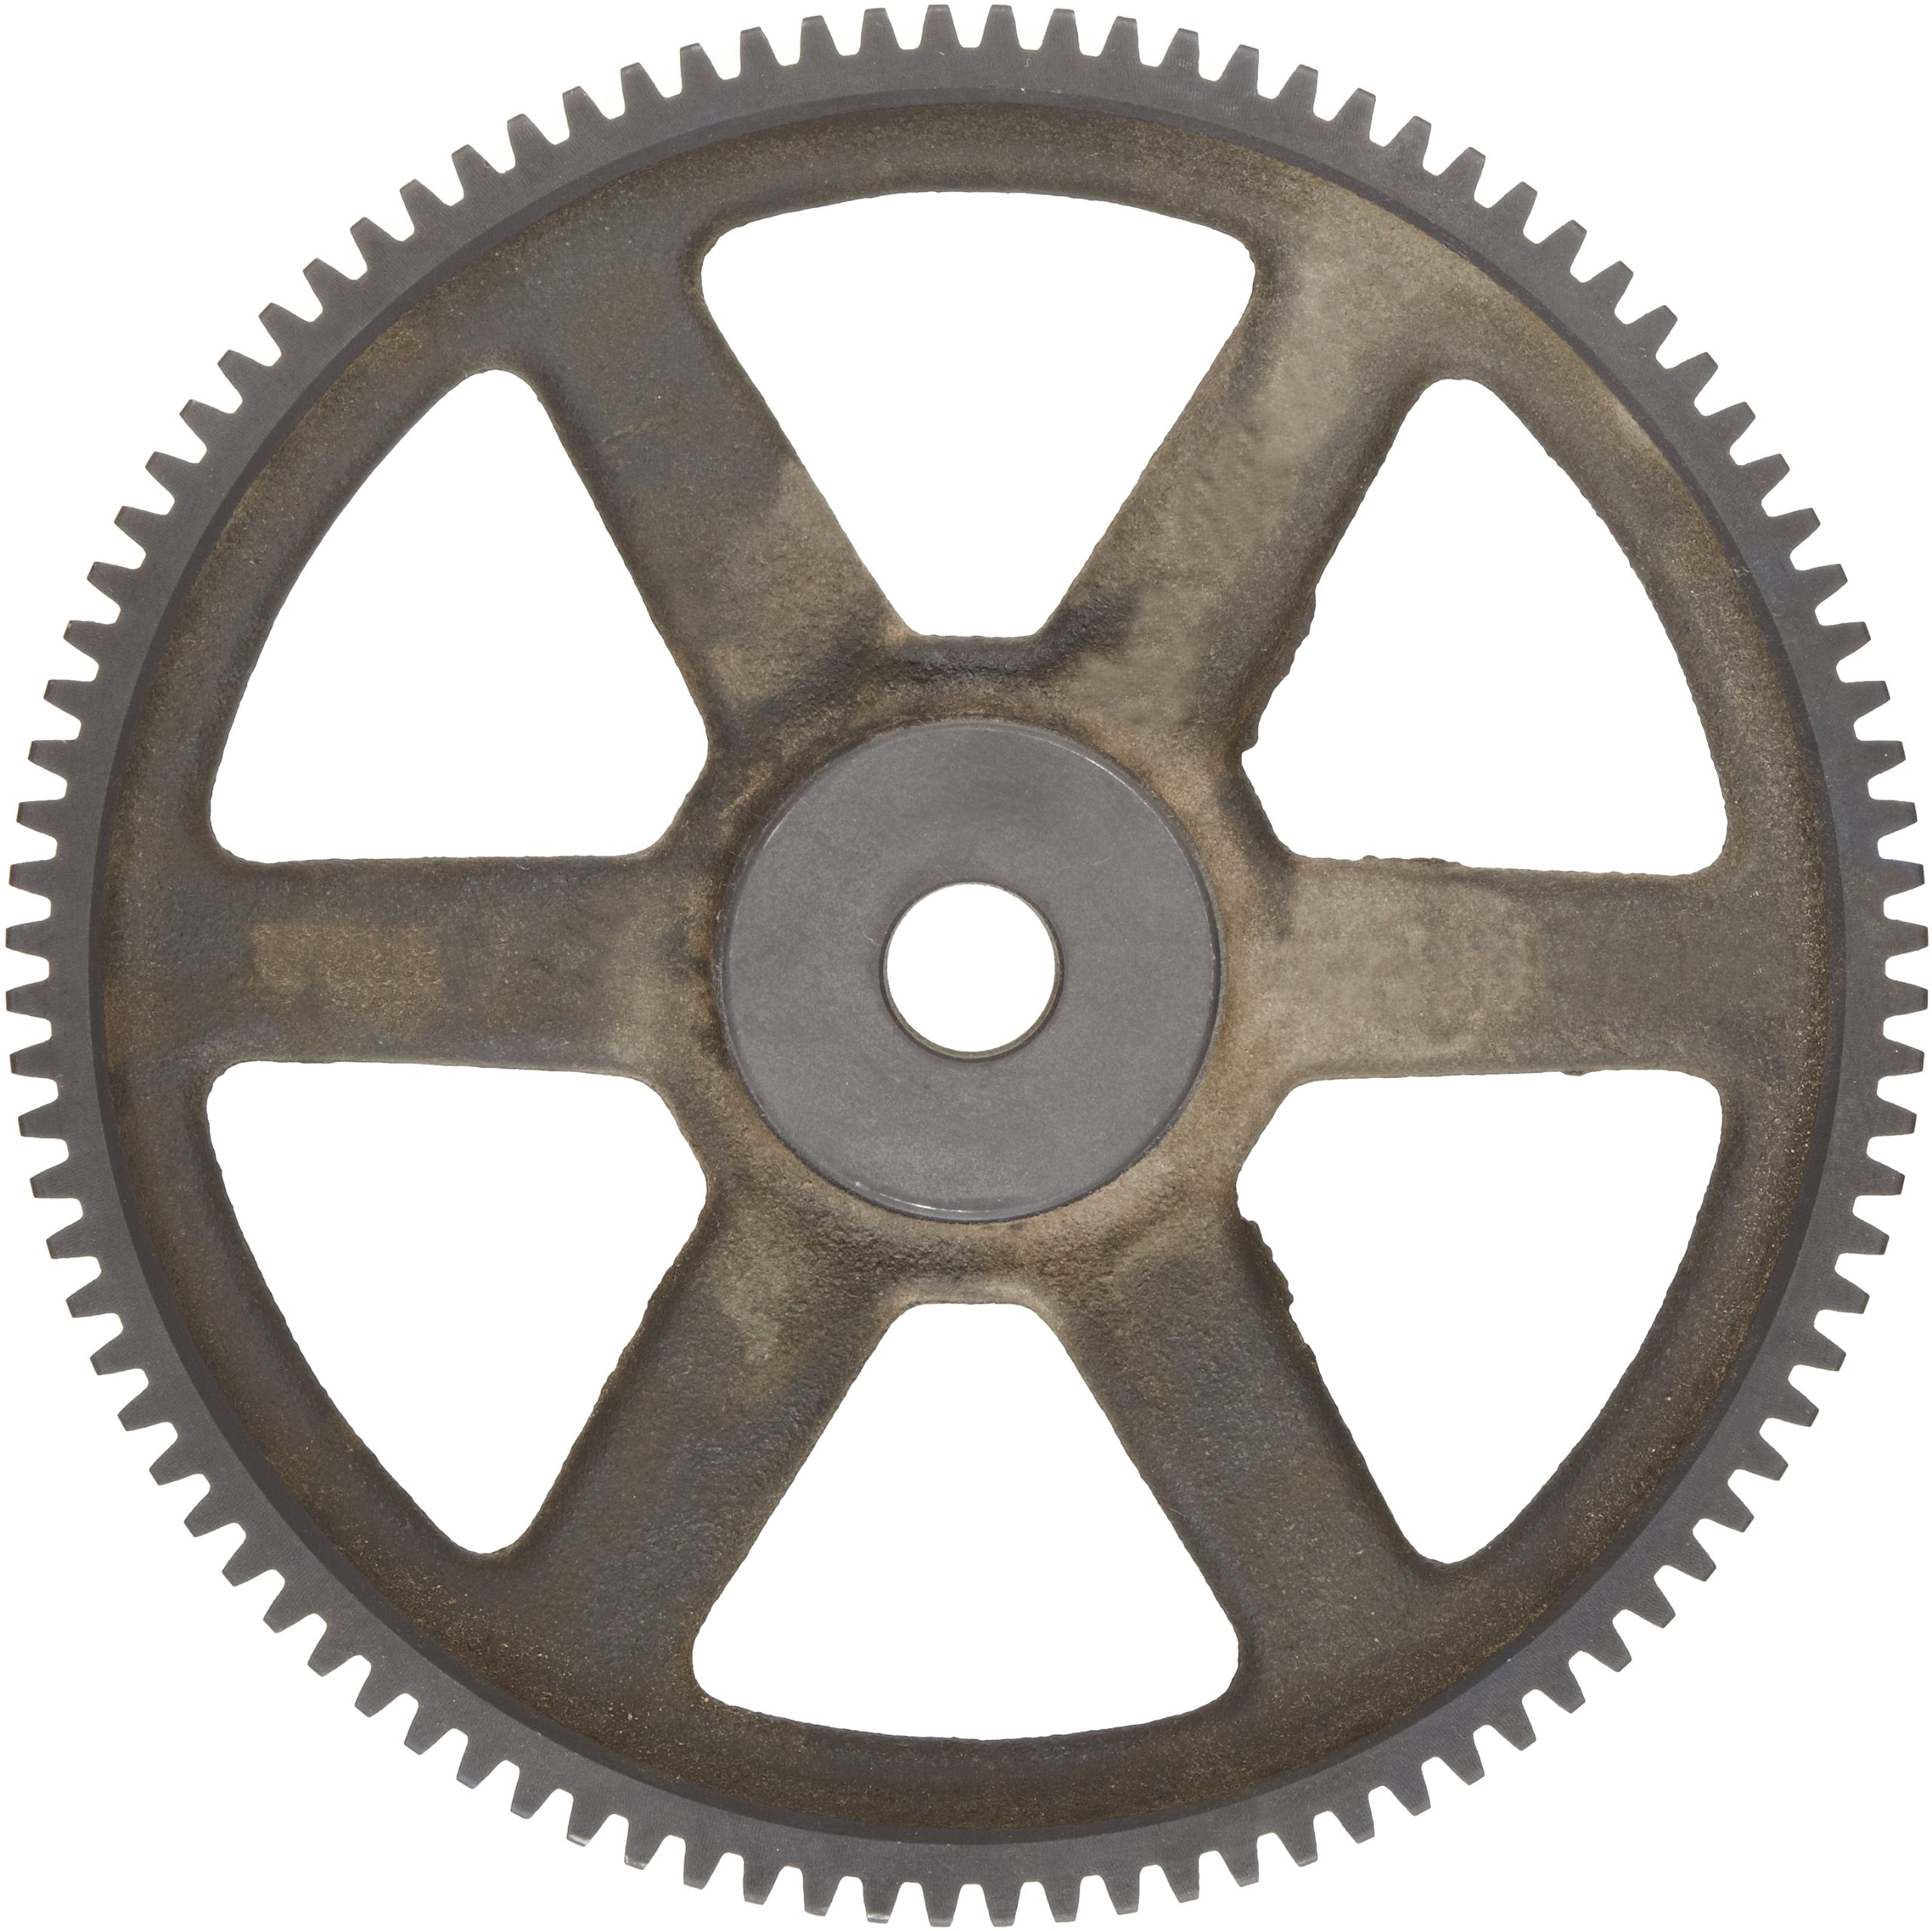
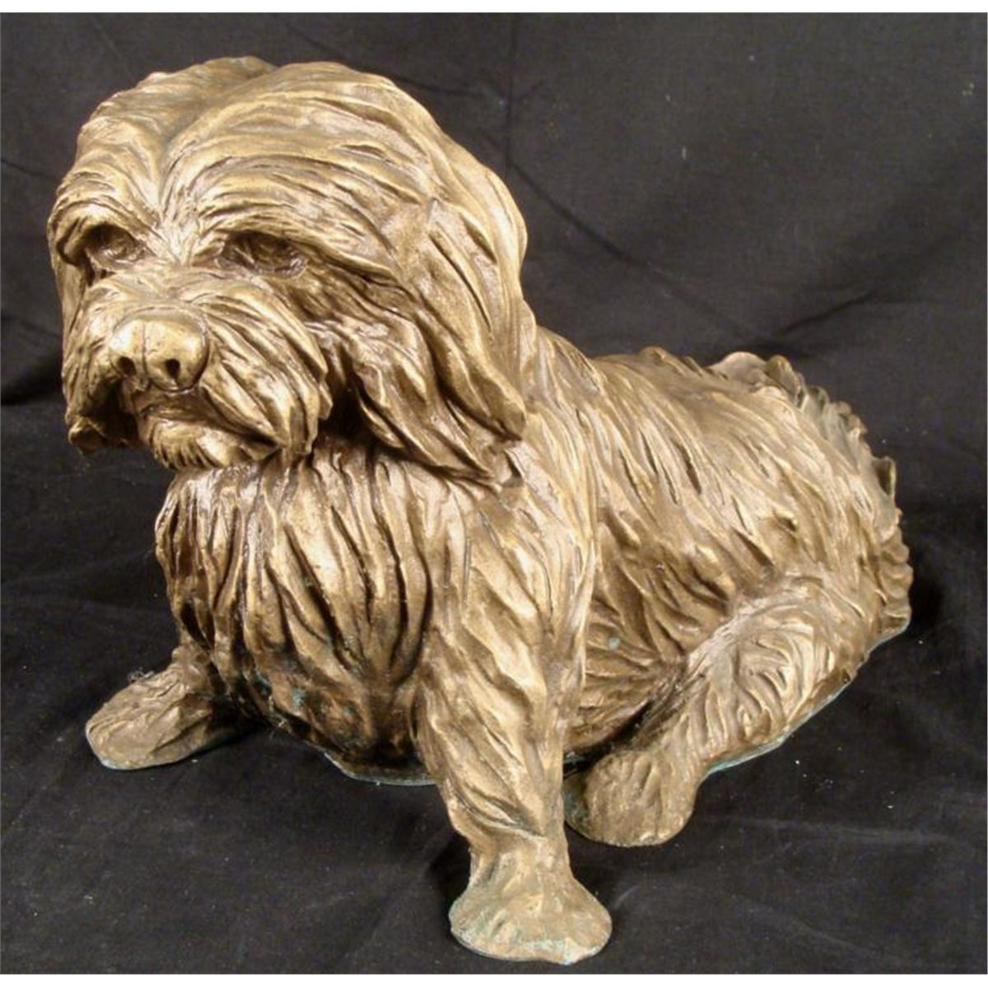

Slide 6
How does the casting process work?

Slide 7
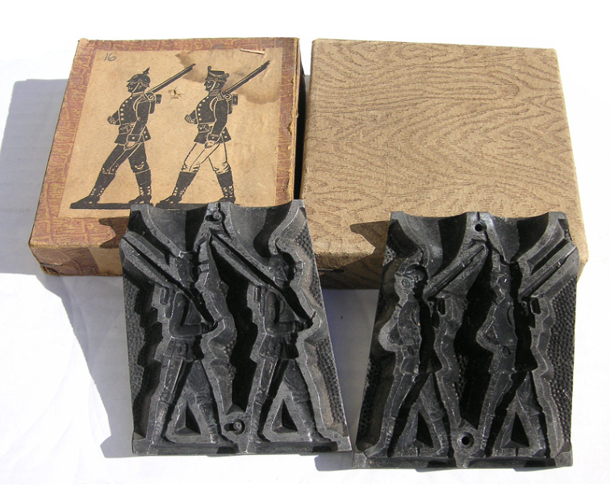
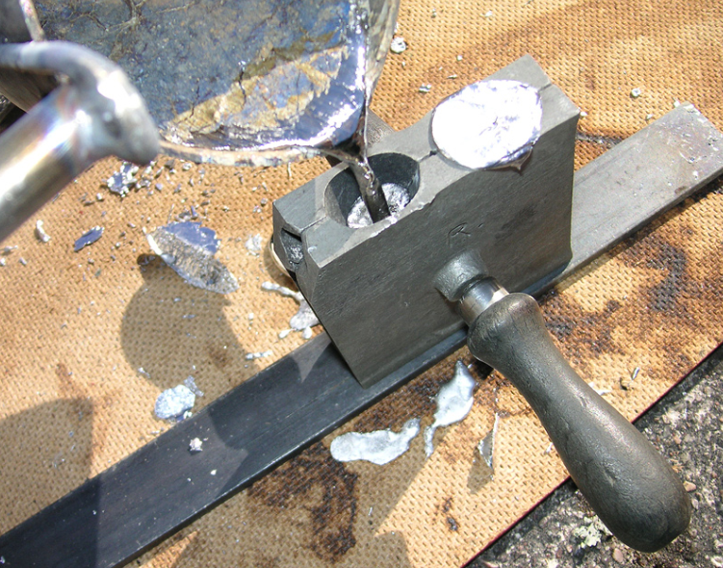
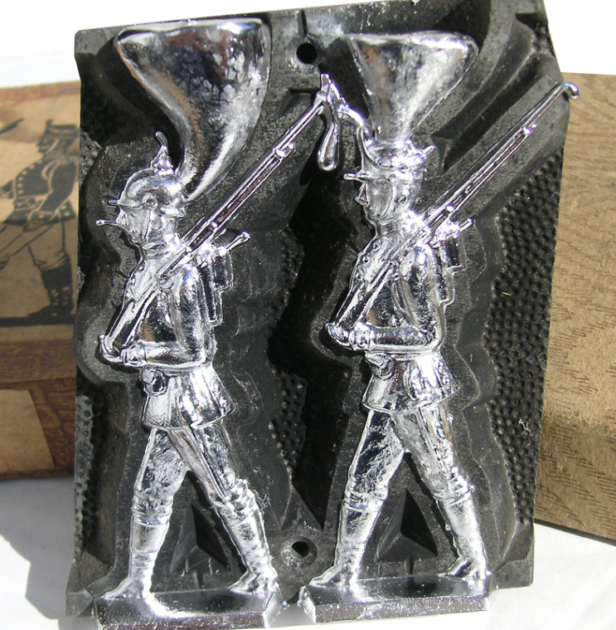
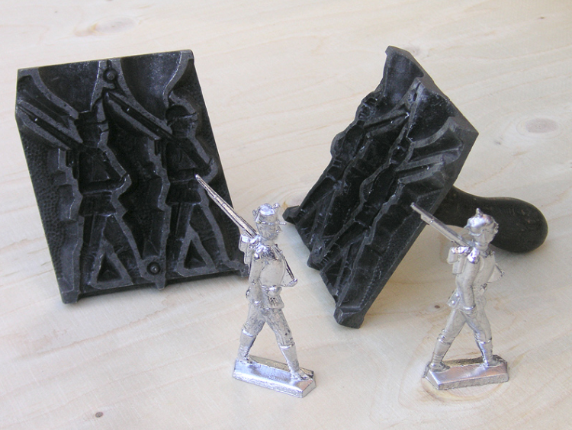

Slide 8
When should casting be used?

Slide 9
Applicability
Advantages
Easier to create complex shapes
Scalable: backyard to industry
Possibility of rapid bulk manufacturing
Disadvantages
Safety considerations
Structural integrity
Shrinkage, misruns, coldshuts, inclusions, parting line

Slide 10
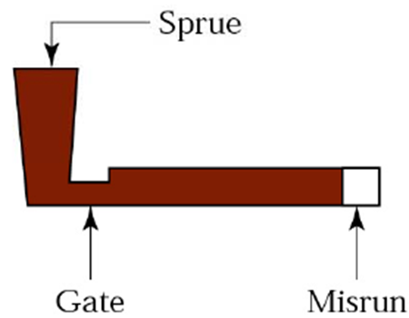
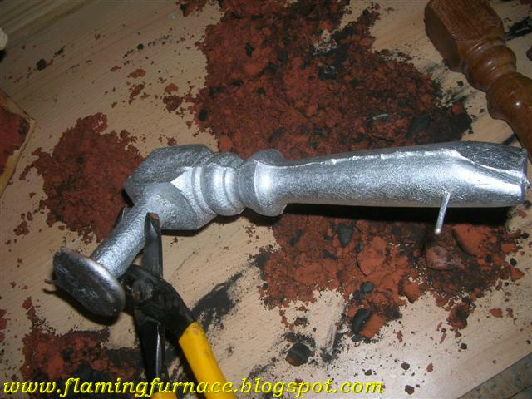
Notes:
Examples of Shrinkage, misruns, coldshuts, inclusions, parting line

Slide 11
How do we work around these problems?

Slide 12
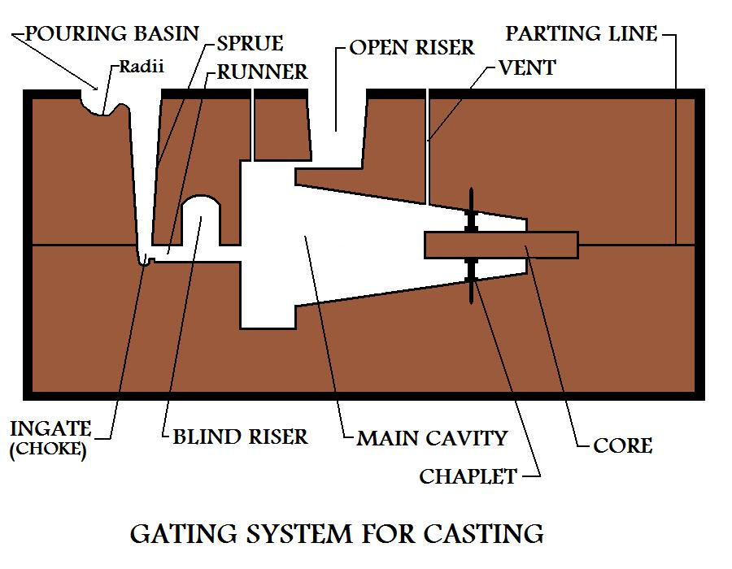
Quality Control
Pouring Variations
Gravity
Vacuum
Low-pressure
Gating system
Risers & sprues
Runners & wells
Gates & chokes
Notes:
Segway with ways to avoid these problems..

Slide 13
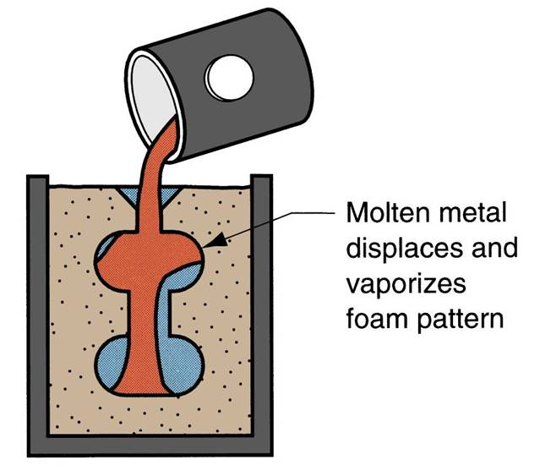
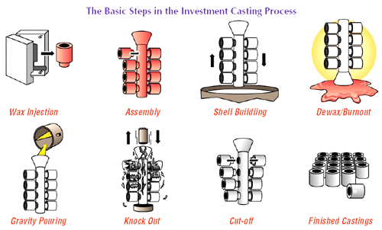
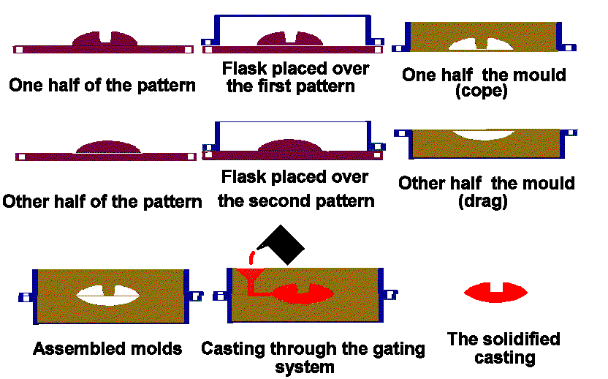
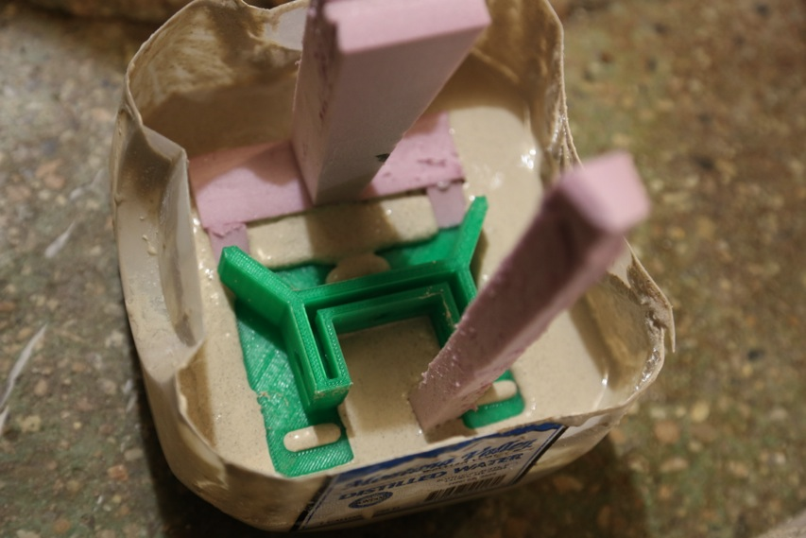
Casting Variations
Expendable molds
Sand/Shell
Plaster
Investment
Evaporative

Slide 14
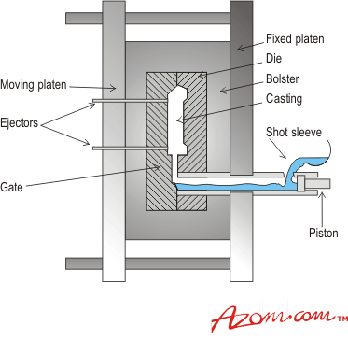
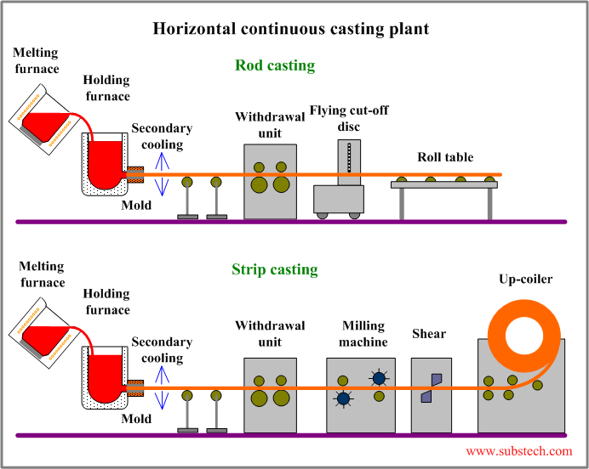
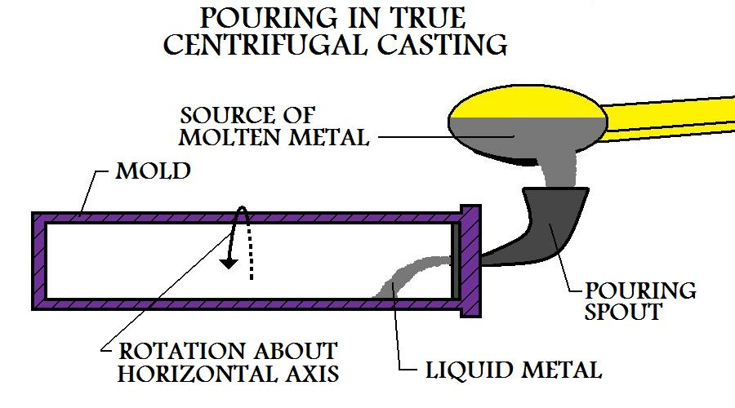
Casting Variations
Non-expendable molds
Permanent mold
Die
Centrifugal
Continuous

Slide 15
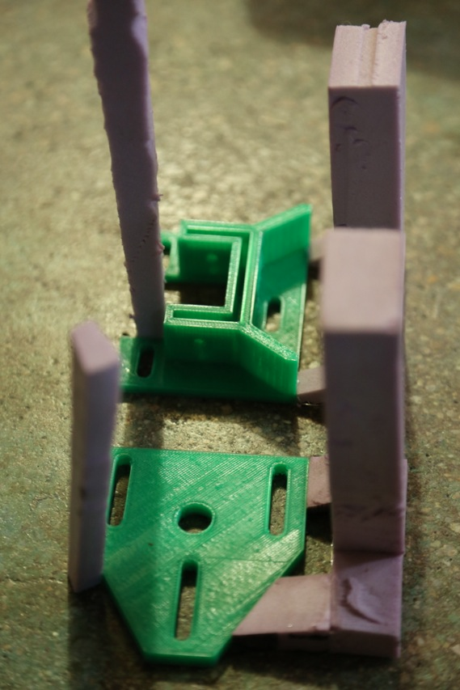
Plaster mold build time

