Slide 1
Crash Course in Mechatronics
Mar. 22, 2014

Slide 2
Mechatronics
A design process that includes a combination of mechanical engineering, electrical engineering, telecommunications engineering, control engineering and computer engineering

Slide 3
Why Mechatronics?
To design simpler devices to perform more complex roles and varied functions

Slide 4
How to Build Using Mechatronics?
Understand Mechanical Aspect
Actuators
Power Transmission
Understand Electrical Aspect
Switches
Variable Resistors
Voltage Regulators
Other sensors
Understanding Digital Logic

Slide 5
How to Build Using Mechatronics?
Understand Mechanical Aspect
Actuators
Power Transmission
Understand Electrical Aspect
Switches
Variable Resistors
Voltage Regulators
Other sensors
Understanding Digital Logic

Slide 6
Mechanical Aspect
Actuators

Slide 7
Actuators
Rotational
DC Brush Motor
DC Brushless Motor
Stepper Motor
Servo Motor
Linear
Mechanical
Lead Screw
Rack and Pinion
Cams
Hydraulic Pistons
Pneumatic Pistons
Magnetic

Slide 8
Actuators
Rotational
DC Brush Motor
DC Brushless Motor
Stepper Motor
Servo Motor
Linear
Mechanical
Lead Screw
Rack and Pinion
Cams
Hydraulic Pistons
Pneumatic Pistons
Magnetic

Slide 9
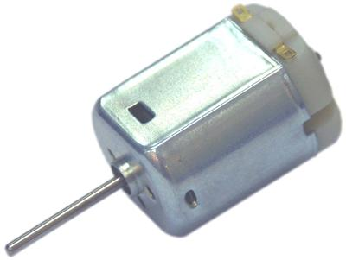
DC Brush Motor
Pros:
Low initial cost
High reliability
Simple control
Cons:
Life span at high intensity
Maintenance
When to use:
Need simple rotation in either one or two directions
Low to medium intensity applications
Don’t need positional accuracy
Don’t need high efficiency

Slide 10
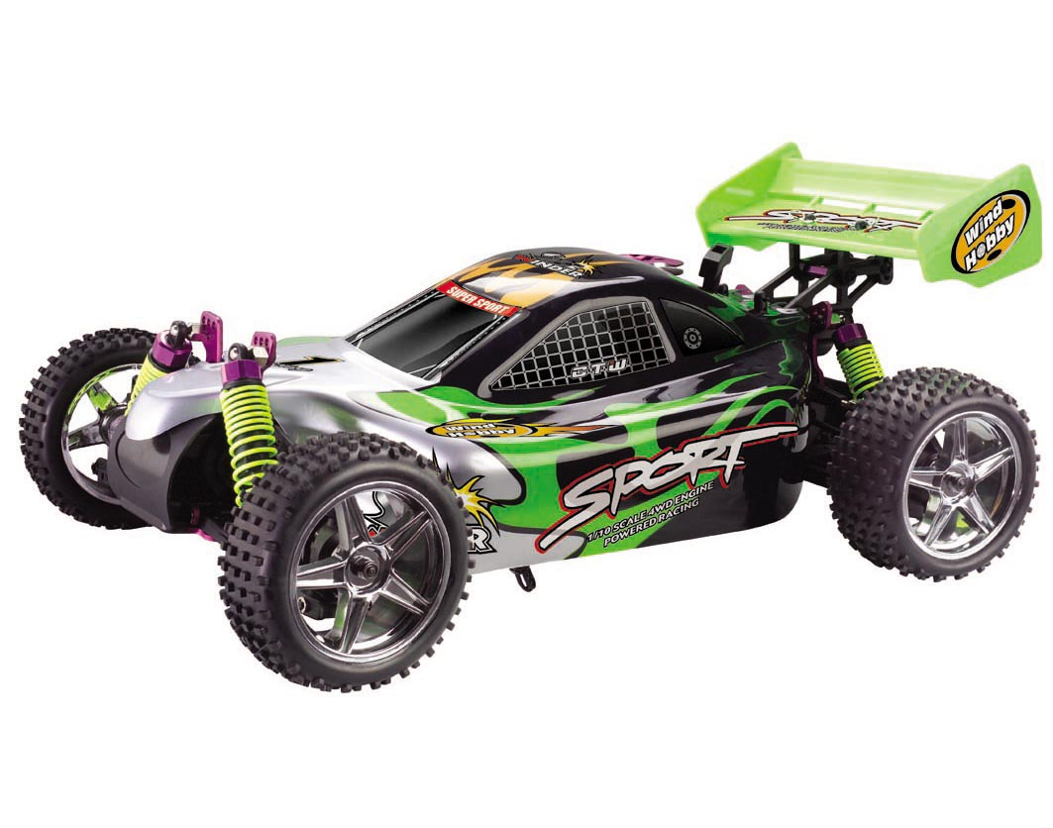
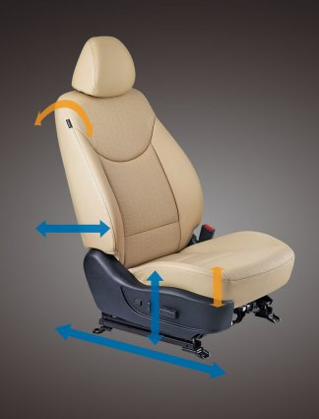
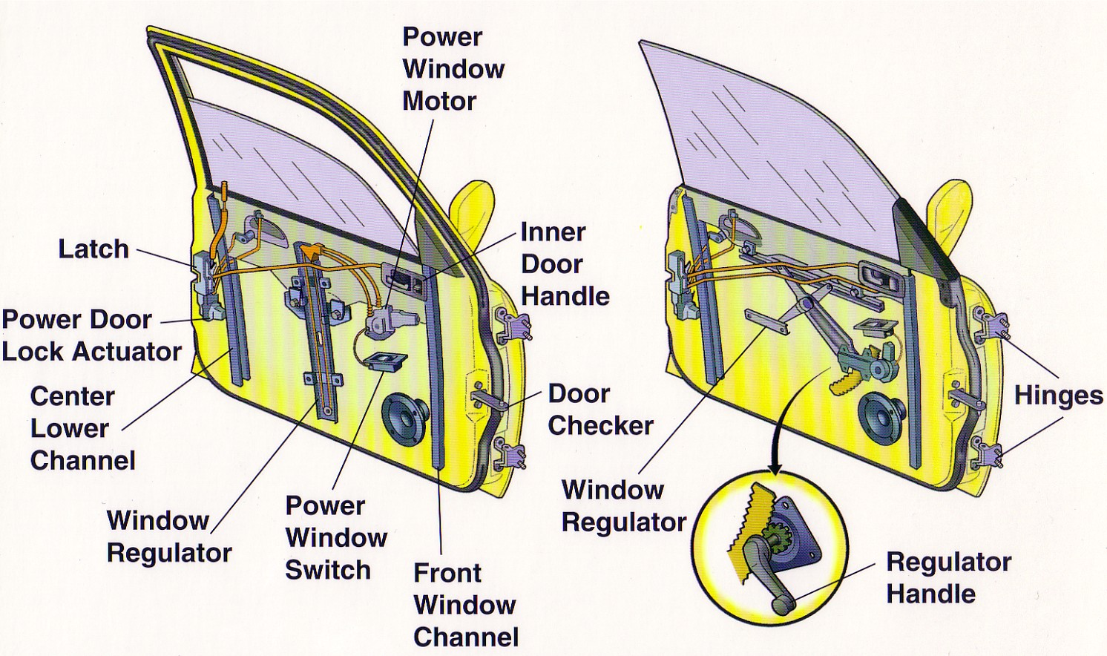

Slide 11
Actuators
Rotational
DC Brush Motor
DC Brushless Motor
Stepper Motor
Servo Motor
Linear
Mechanical
Lead Screw
Rack and Pinion
Cams
Hydraulic Pistons
Pneumatic Pistons
Magnetic

Slide 12
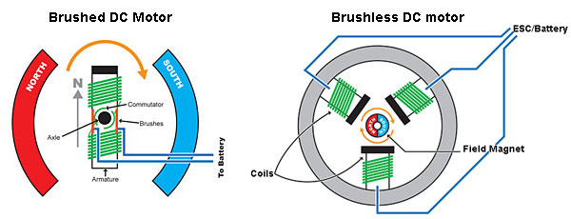

Slide 13
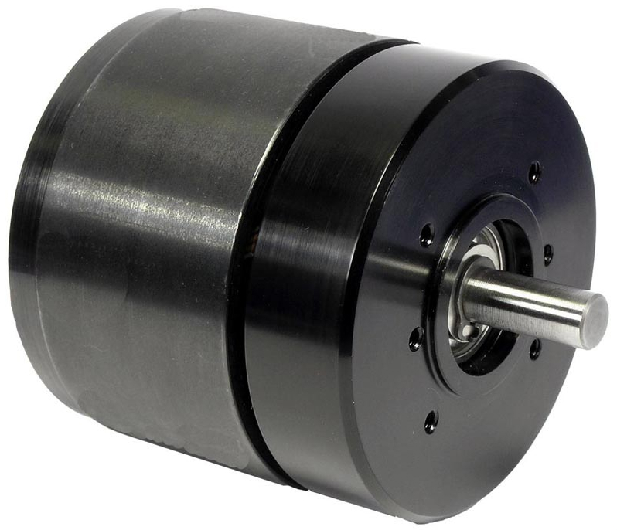
DC Brushless Motor
Pros:
Higher torque (vs. brush)
Increased reliability
Longevity
Reduced noise
Efficiency
Cons:
Cost
Need controller or driver
When to use:
Maintenance-free operation
High speeds
High intensity applications
High torque required

Slide 14
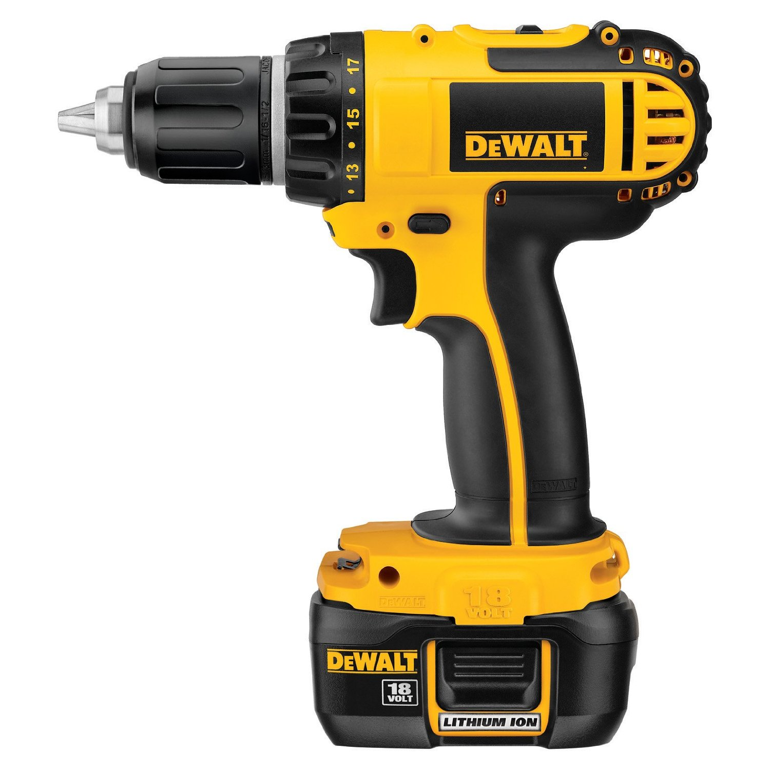
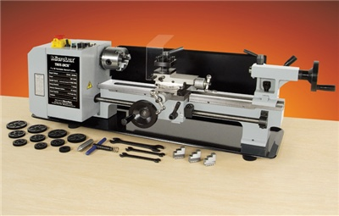
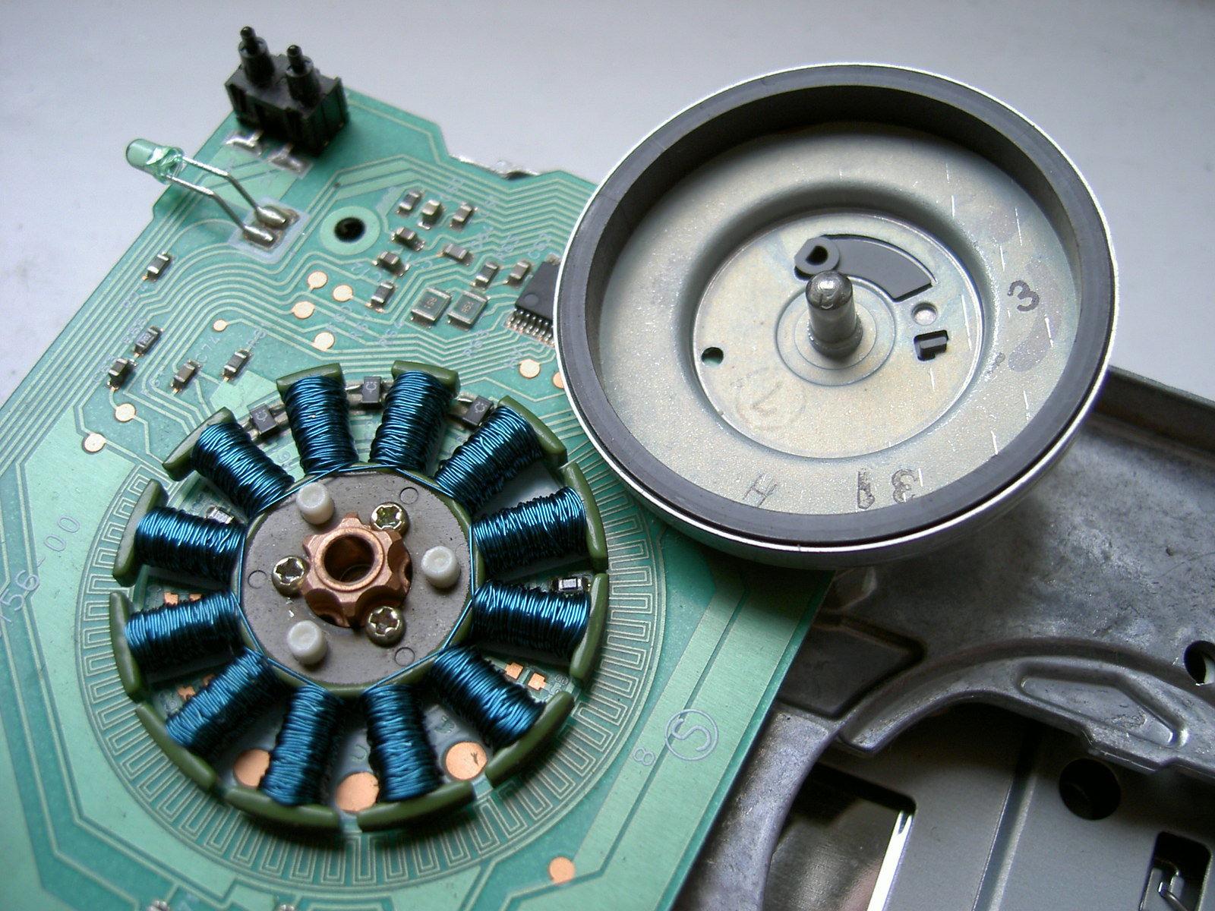
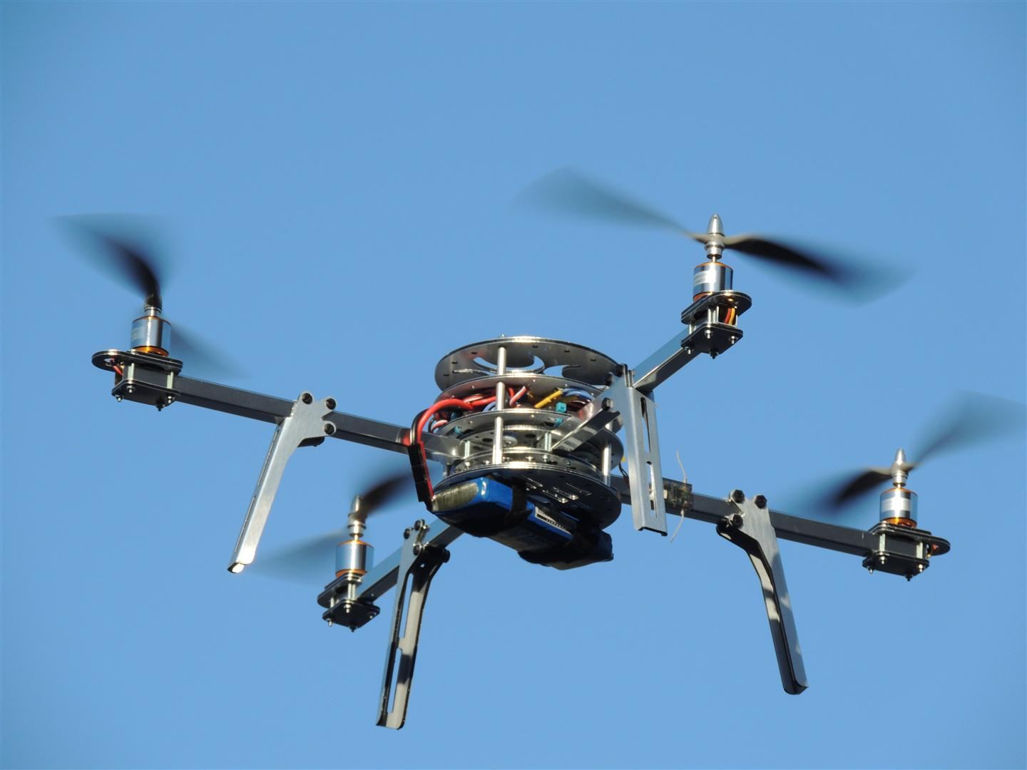
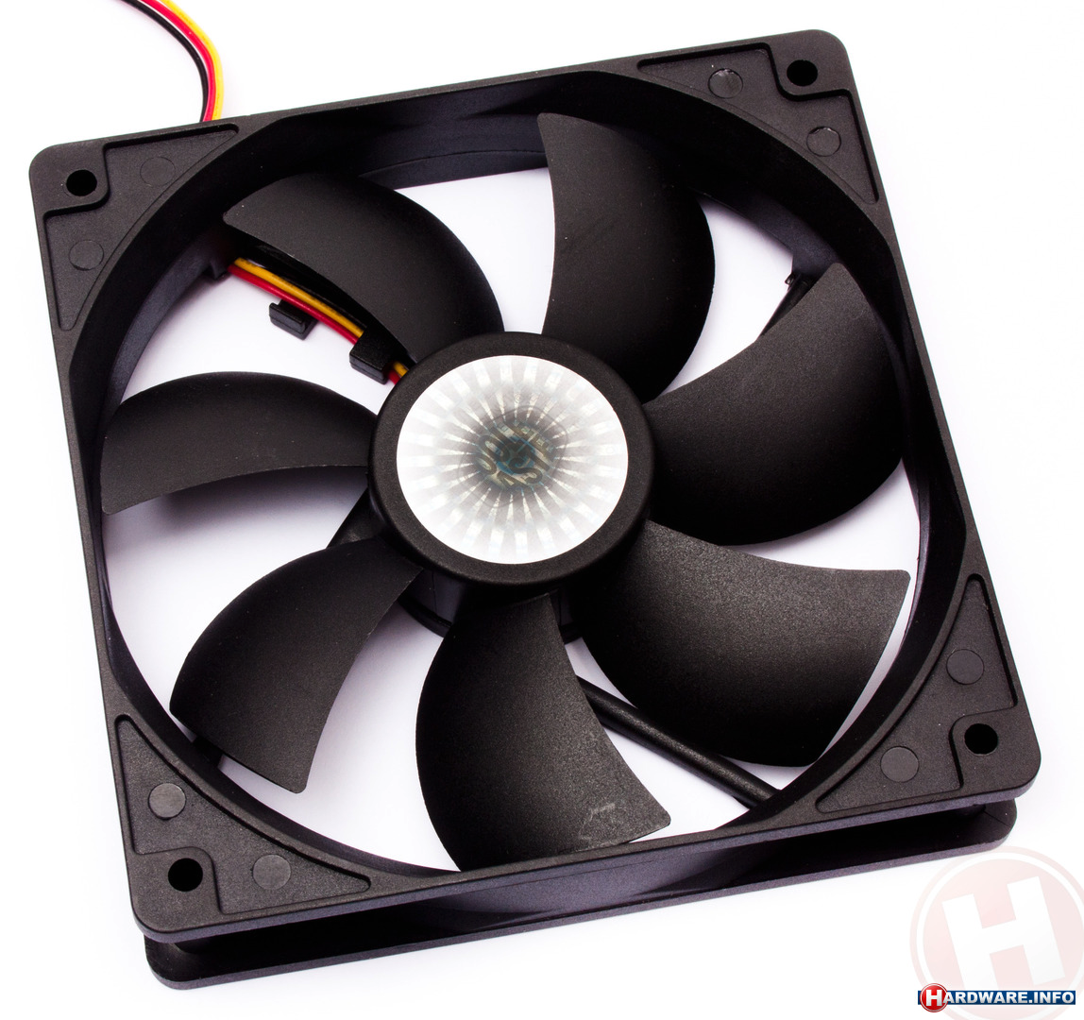

Slide 15
Actuators
Rotational
DC Brush Motor
DC Brushless Motor
Stepper Motor
Servo Motor
Linear
Mechanical
Lead Screw
Rack and Pinion
Cams
Hydraulic Pistons
Pneumatic Pistons
Magnetic

Slide 16
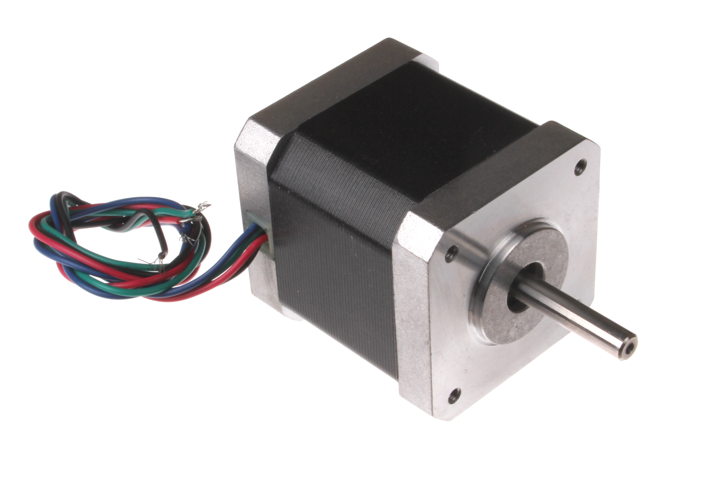
Stepper Motor
Pros:
High positional accuracy
High torque
Cons:
Energy inefficient
Open loop
Need stepper motor driver
When to use:
Positional accuracy required (CNC applications)
Low to medium speeds

Slide 17
Actuators
Rotational
DC Brush Motor
DC Brushless Motor
Stepper Motor
Servo Motor
Linear
Mechanical
Lead Screw
Rack and Pinion
Cams
Hydraulic Pistons
Pneumatic Pistons
Magnetic

Slide 18
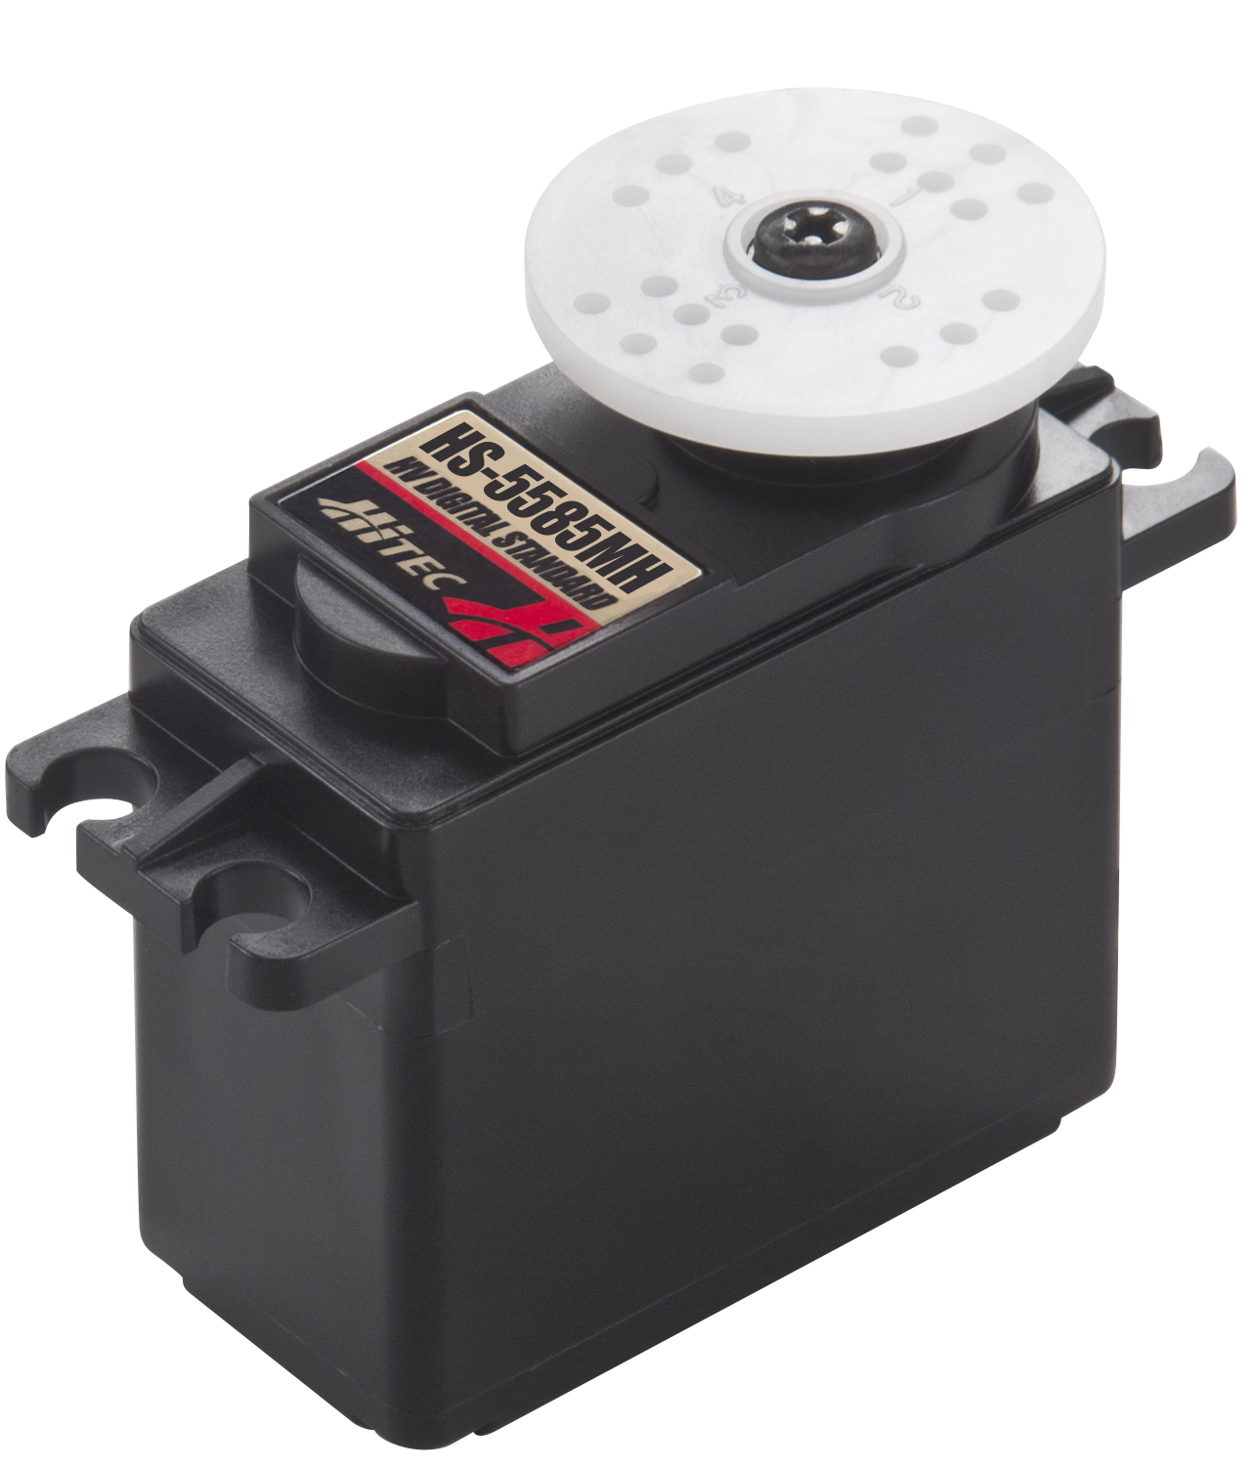
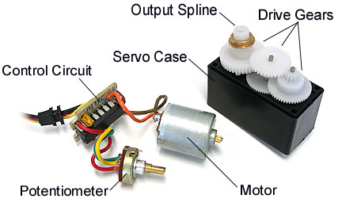

Slide 19
Servo Motor
Pros:
High positional accuracy
Closed loop
High holding torque
Cons:
Limited degree of rotation
Open loop
When to use:
Positional accuracy required
Only need limited degree of motion (latches, shutters, etc.)

Slide 20
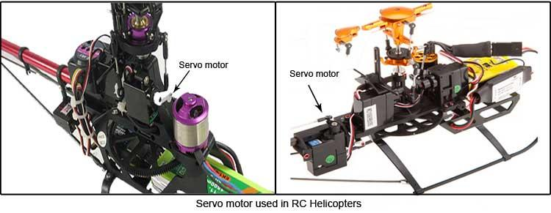
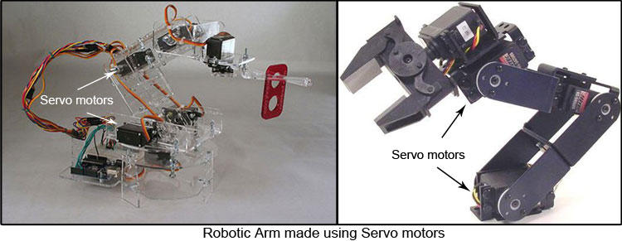

Slide 21
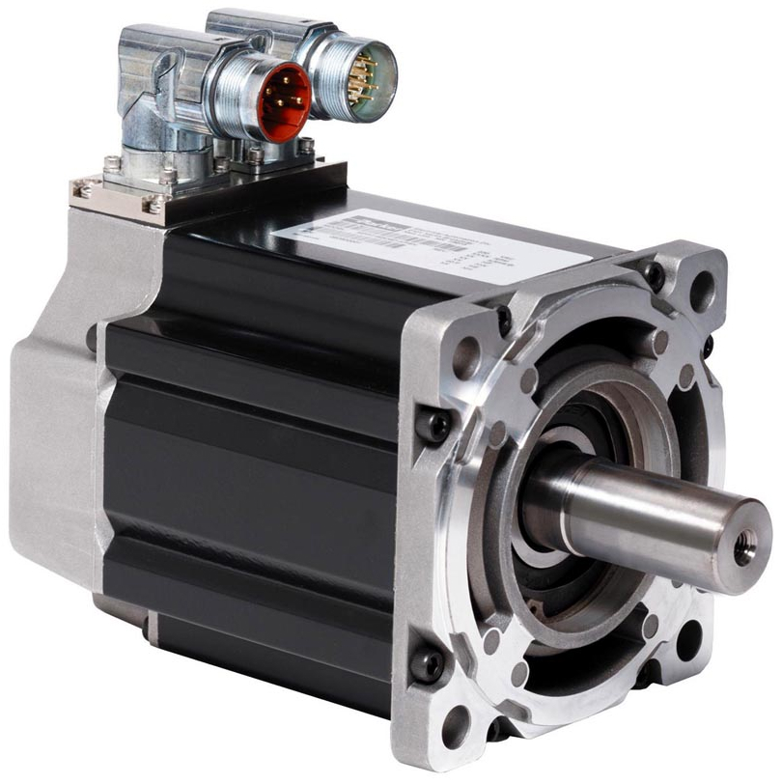
Brushless Servo Motor

Slide 22
Actuators
Rotational
DC Brush Motor
DC Brushless Motor
Stepper Motor
Servo Motor
Linear
Mechanical
Lead Screw
Rack and Pinion
Cams
Hydraulic Pistons
Pneumatic Pistons
Magnetic

Slide 24
Actuators
Rotational
DC Brush Motor
DC Brushless Motor
Stepper Motor
Servo Motor
Linear
Mechanical
Lead Screw
Rack and Pinion
Cams
Hydraulic Pistons
Pneumatic Pistons
Magnetic

Slide 25
Lead Screw
Pros:
Large load carrying capacity
Simple
Precise
Large mechanical advantage
Cons:
High degree of friction
Inefficient
Backlash
When to use:
Positional accuracy required
Motion is slow to medium
Z-axis motion is common

Slide 26
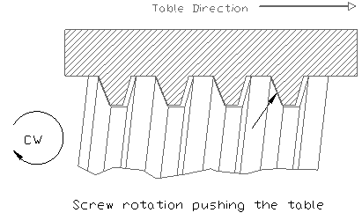

Slide 27
Rack and Pinion
Pros:
Less backlash
Cons:
Less efficient mechanical advantage
When to use:
Quick linear action with large displacement

Slide 28
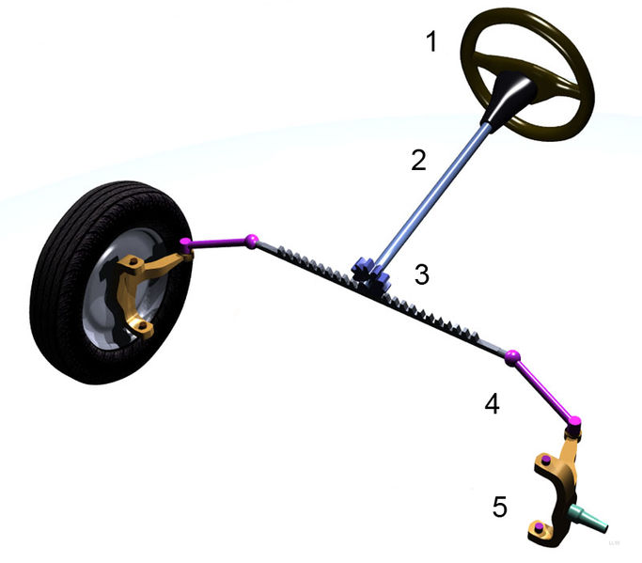
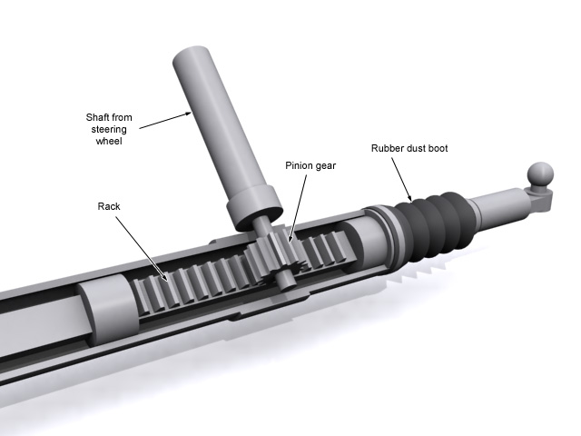
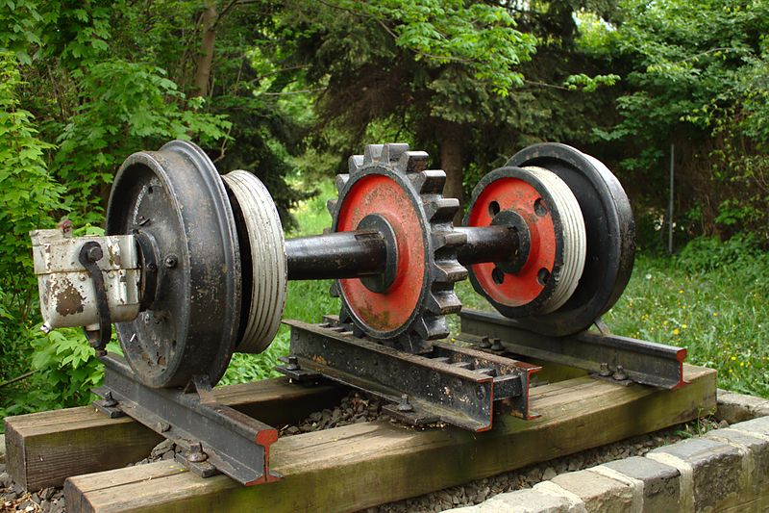
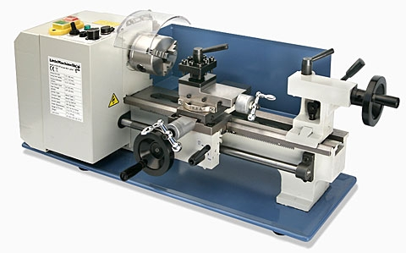

Slide 29
Cam
Pros:
High positional accuracy
Fast action as long as follower can return to position
Cons:
Limited range of motion
When to use:
Positional accuracy required
Only need limited degree of motion

Slide 30
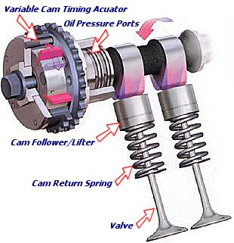

Slide 31
Actuators
Rotational
DC Brush Motor
DC Brushless Motor
Stepper Motor
Servo Motor
Linear
Mechanical
Lead Screw
Rack and Pinion
Cams
Hydraulic Pistons
Pneumatic Pistons
Magnetic

Slide 32
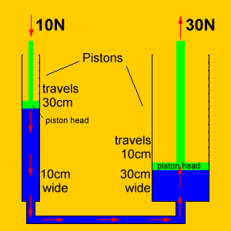

Slide 33
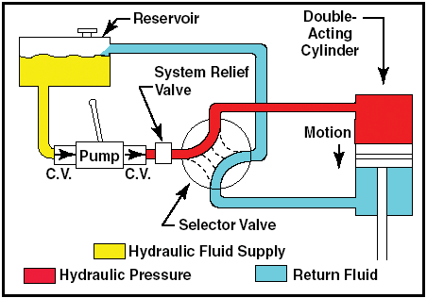

Slide 34
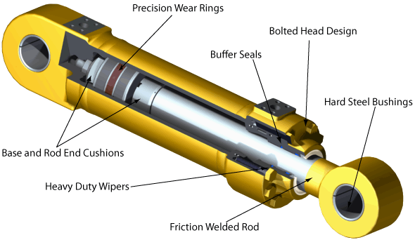
Hydraulic Cylinder
Pros:
Heavy duty
Efficient and consistent work
Easy to spot leakage
Works in hot environments
Cons:
Hydraulic fluid is very corrosive
Needs heavy duty structure
Needs pump
When to use:
Extremely high loads are required

Slide 35
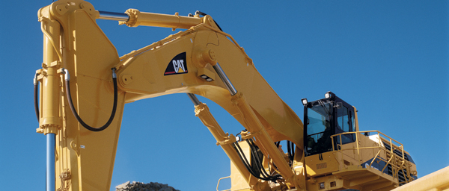
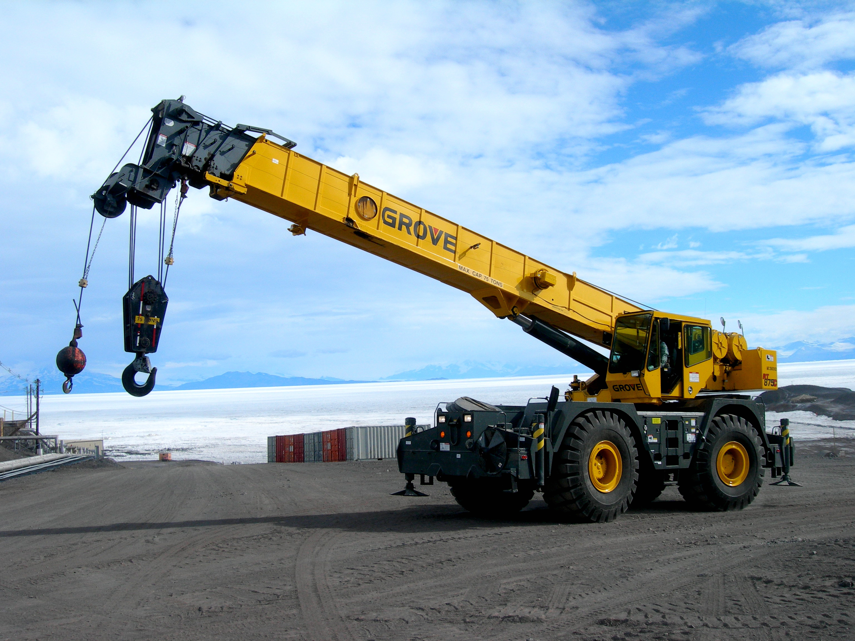

Slide 36
Actuators
Rotational
DC Brush Motor
DC Brushless Motor
Stepper Motor
Servo Motor
Linear
Mechanical
Lead Screw
Rack and Pinion
Cams
Hydraulic Pistons
Pneumatic Pistons
Magnetic

Slide 38
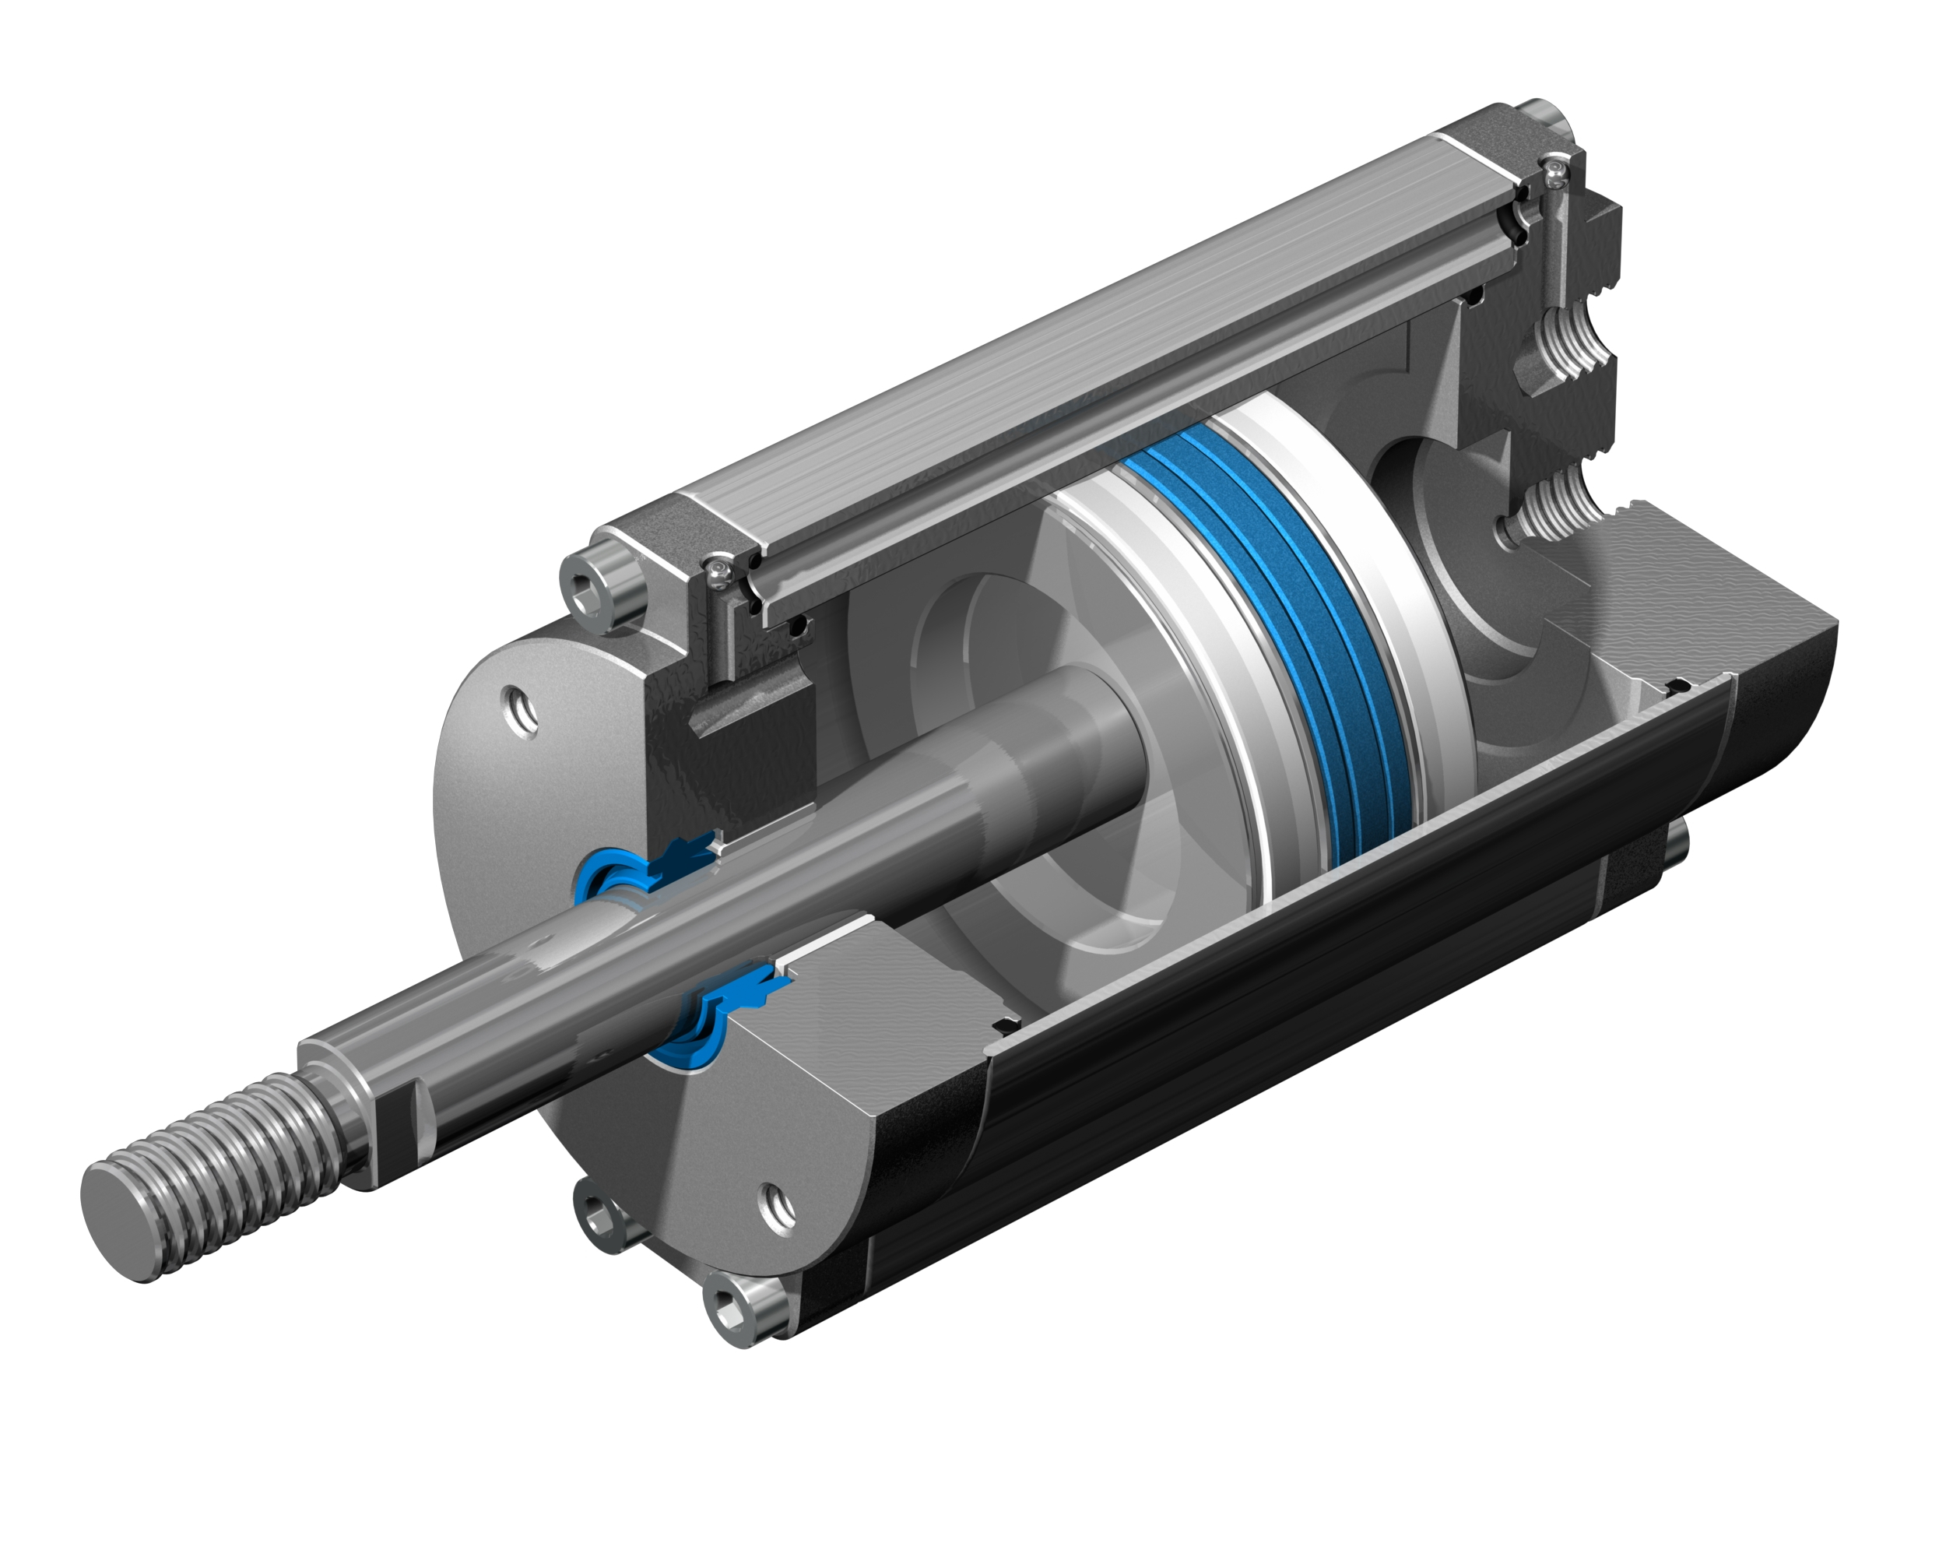
Hydraulic Cylinder
Pros:
Clean
Leakage is not damaging
Cons:
Lower forces
Need compressor
When to use:
Support suspension (gas shocks)
Fast acting linear motion

Slide 39
Actuators
Rotational
DC Brush Motor
DC Brushless Motor
Stepper Motor
Servo Motor
Linear
Mechanical
Lead Screw
Rack and Pinion
Cams
Hydraulic Pistons
Pneumatic Pistons
Magnetic

Slide 40
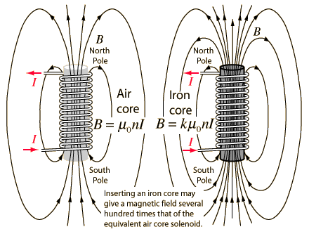

Slide 41
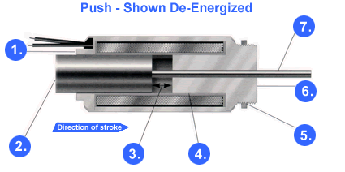
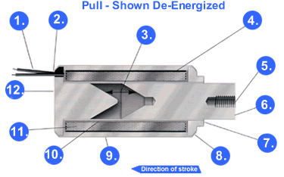

Slide 42
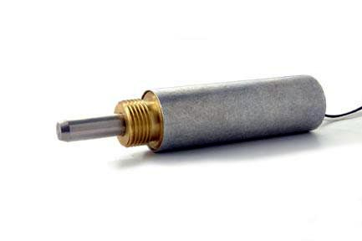
Solenoid Actuator
Pros:
Quick
Simple to control
Cons:
Limited range of motion
Binary
When to use:
Binary state (latch on/off)
Fast acting

Slide 43
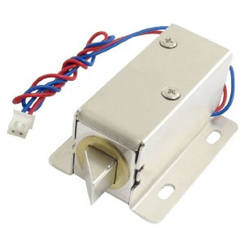
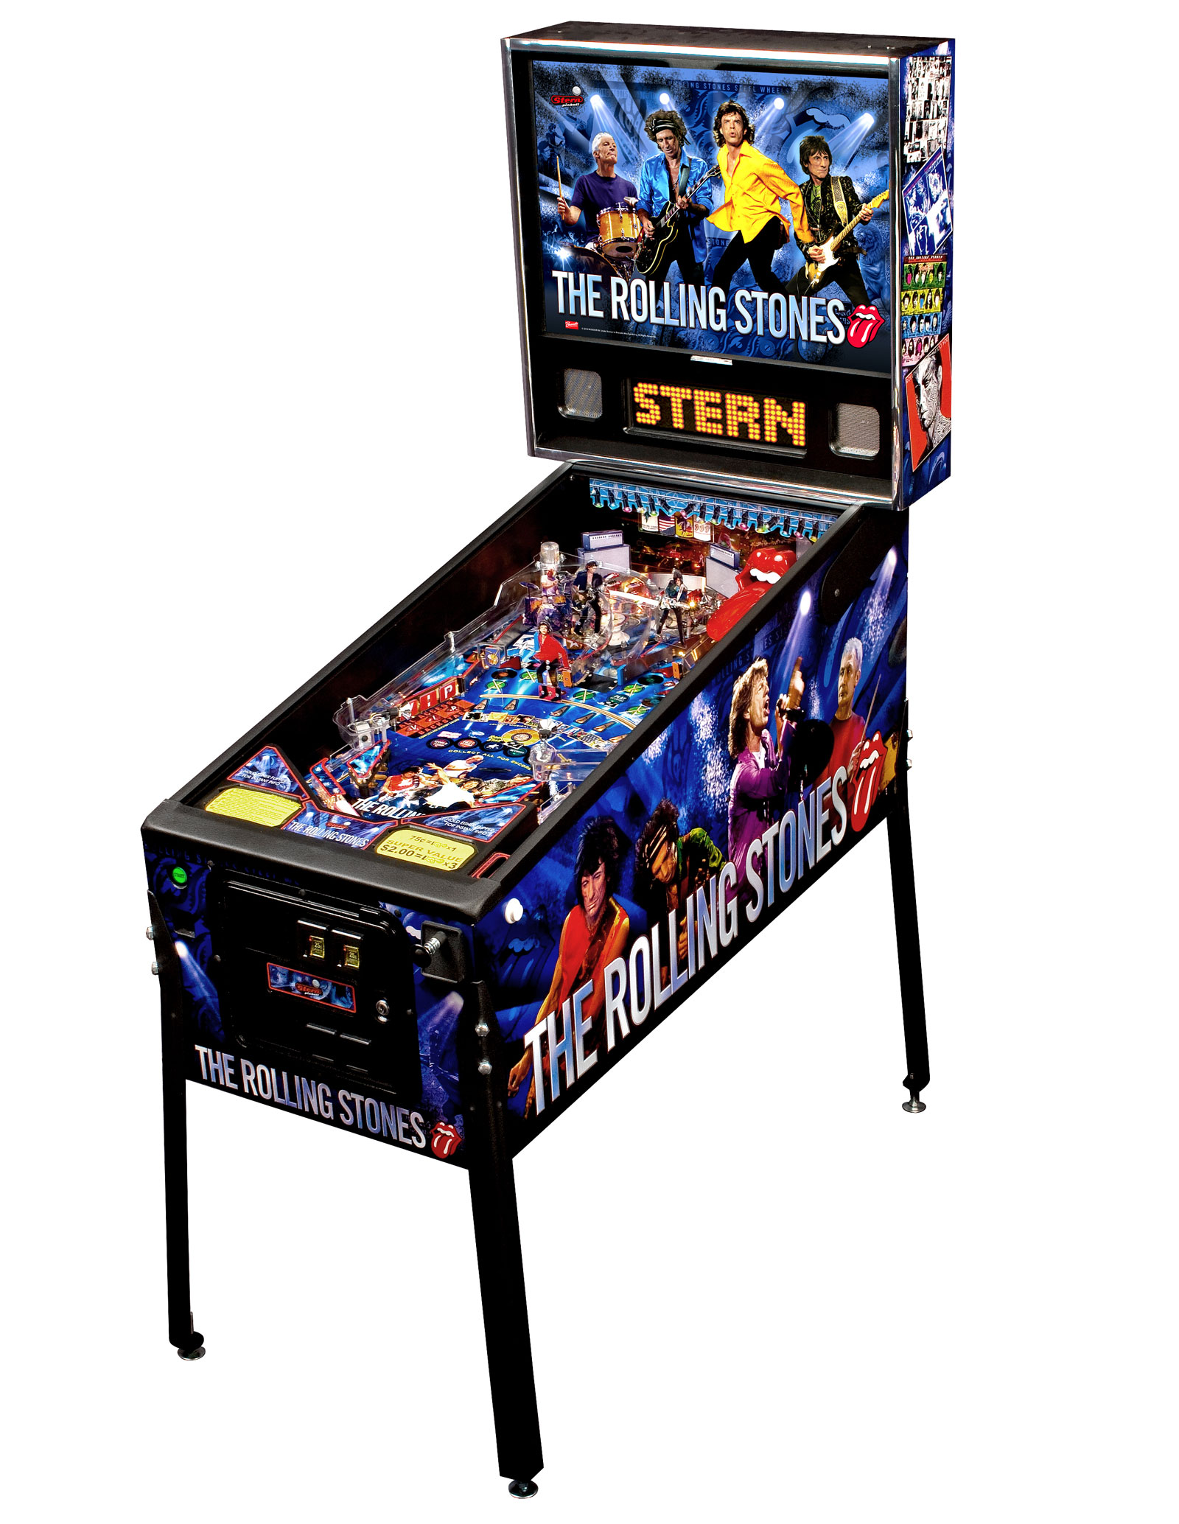
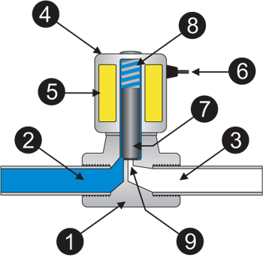

Slide 44
Actuators
Rotational
DC Brush Motor
DC Brushless Motor
Stepper Motor
Servo Motor
Linear
Mechanical
Lead Screw
Rack and Pinion
Cams
Hydraulic Pistons
Pneumatic Pistons
Magnetic

Slide 45
How to Build Using Mechatronics?
Understand Mechanical Aspect
Actuators
Power Transmission
Understand Electrical Aspect
Switches
Variable Resistors
Voltage Regulators
Other sensors
Understanding Digital Logic

Slide 46
How to Build Using Mechatronics?
Understand Mechanical Aspect
Actuators
Power Transmission
Understand Electrical Aspect
Switches
Variable Resistors
Voltage Regulators
Other sensors
Understanding Digital Logic

Slide 47
Mechanical Aspect
Power Transmission

Slide 48
Power Transmission
Wheel and Axle
Gears
Pulleys
Belt Drive
Sprocket and Chain
Friction Drive
Bearings
Linear
Rotational

Slide 49
Power Transmission
Wheel and Axle
Gears
Pulleys
Belt Drive
Sprocket and Chain
Friction Drive
Bearings
Linear
Rotational

Slide 50
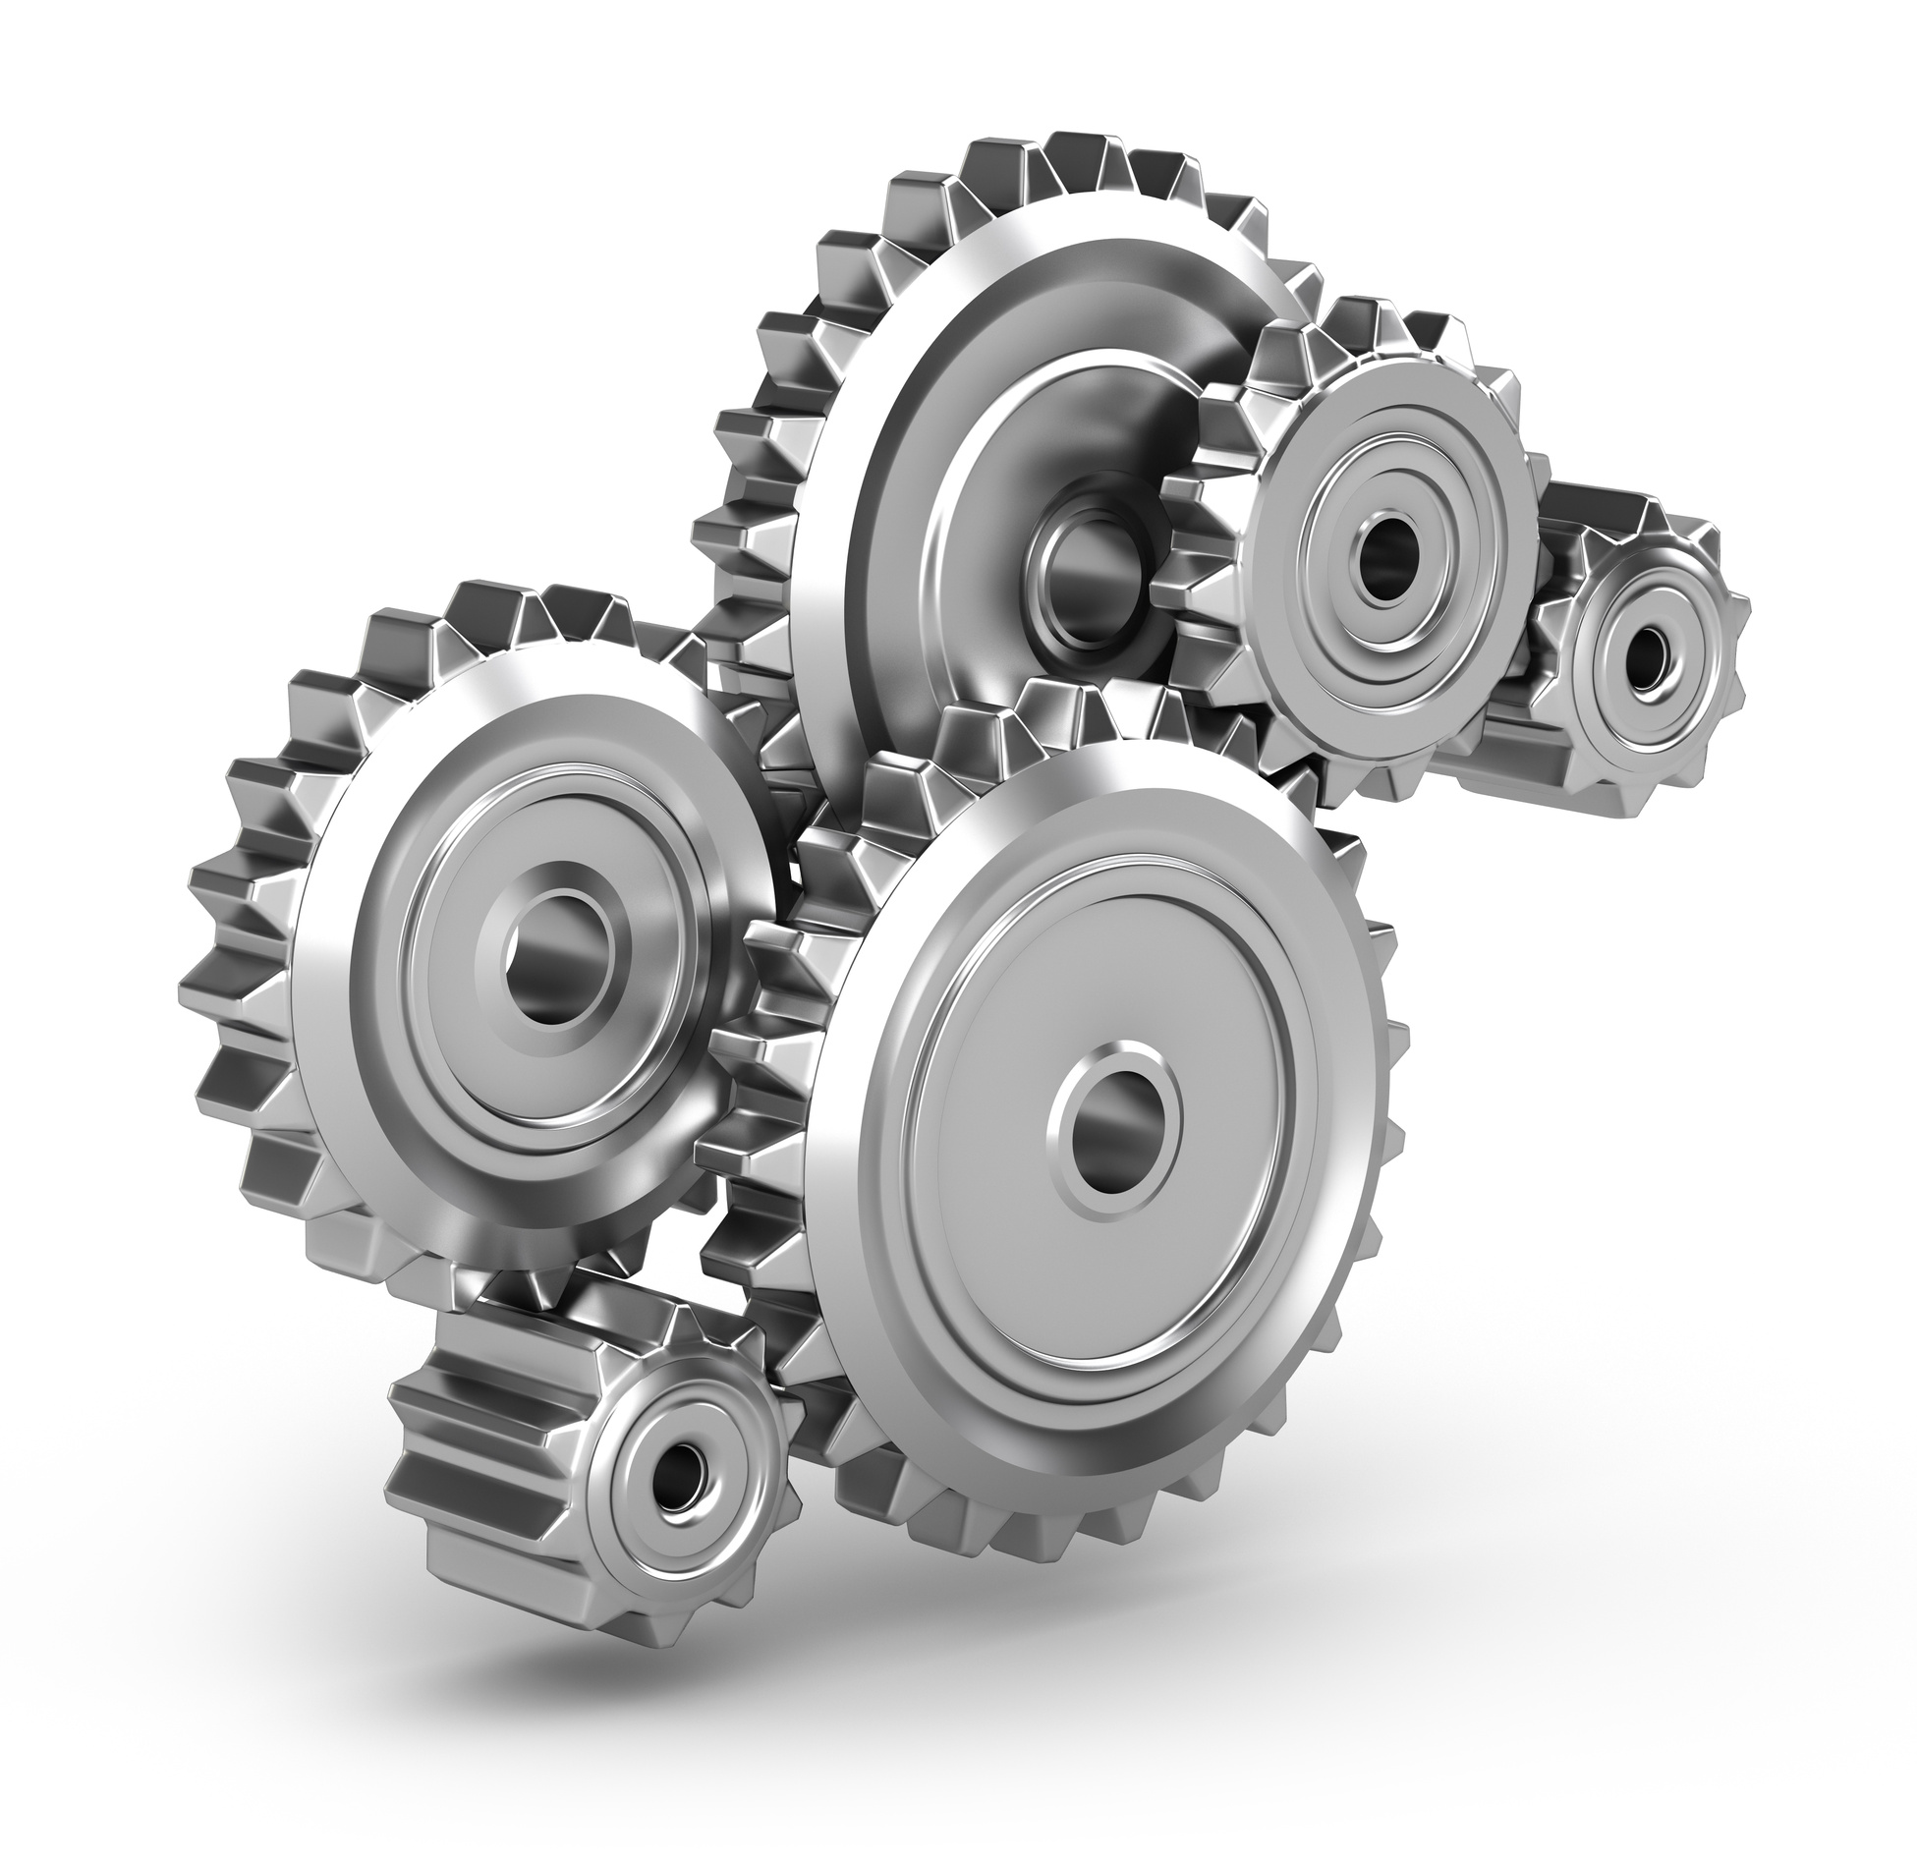
Gears
Pros:
Very robust and reliable
Precise
Cons:
Loud
Need to be close to motor
Need to be parallel with motor axle
When to use:
When motion axle is close to motor
Need reliable system

Slide 51
Power Transmission
Wheel and Axle
Gears
Pulleys
Belt Drive
Sprocket and Chain
Friction Drive
Bearings
Linear
Rotational

Slide 52
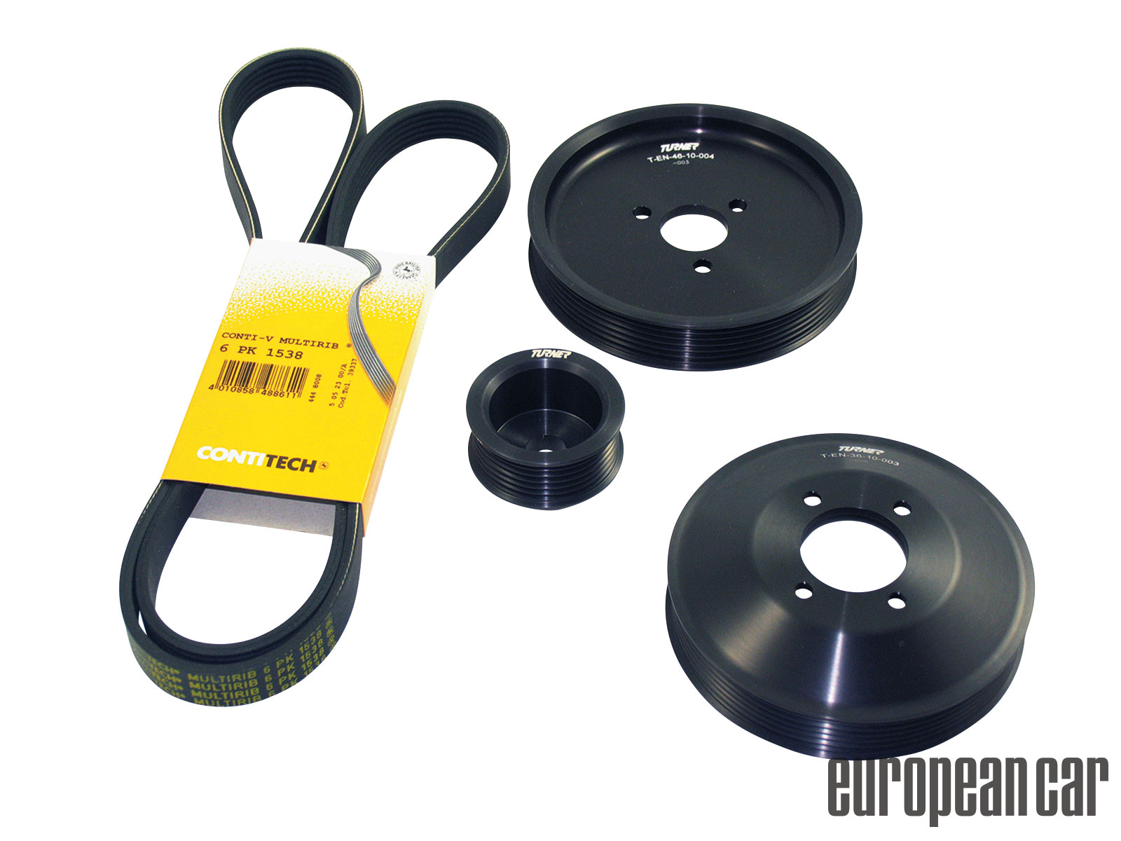
Pulley System
Pros:
Quiet
Does not need to be parallel with or close to motor axle
Cons:
Slippage
Flexibility
Breakage
When to use:
When rotational accuracy is not required

Slide 53
Power Transmission
Wheel and Axle
Gears
Pulleys
Belt Drive
Sprocket and Chain
Friction Drive
Bearings
Linear
Rotational

Slide 54
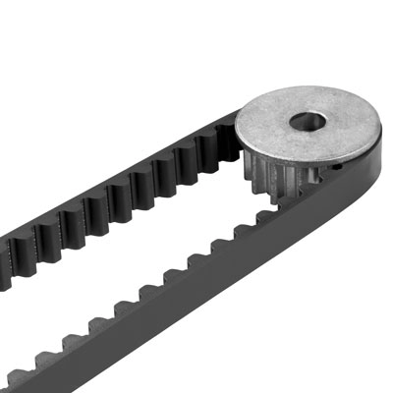
Belt Drive
Pros:
Quiet
Does not need to be parallel with or close to motor axle
Precise
Cons:
Breakage
When to use:
When rotational accuracy is required
Long range transmission

Slide 55
Power Transmission
Wheel and Axle
Gears
Pulleys
Belt Drive
Sprocket and Chain
Friction Drive
Bearings
Linear
Rotational

Slide 56
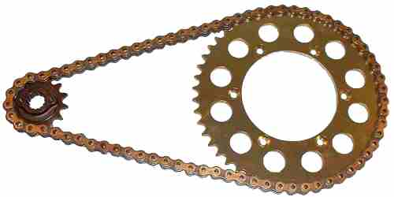
Sprocket and Chain
Pros:
Precise
Does not need to be close to motor axle
Will not slip
Cons:
Need to be greased
Loud
When to use:
When strong power transmission is required
Long range transmission

Slide 57
Power Transmission
Wheel and Axle
Gears
Pulleys
Belt Drive
Sprocket and Chain
Friction Drive
Bearings
Linear
Rotational

Slide 58
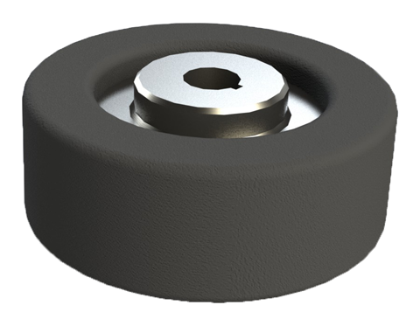
Friction Drive
Pros:
Simple
Quiet
Cons:
Need to be parallel and close to motor
Slippage
When to use:
When simple power transmission is required
Motion axle is next to motor axle

Slide 60
Power Transmission
Wheel and Axle
Gears
Pulleys
Belt Drive
Sprocket and Chain
Friction Drive
Bearings
Linear
Rotational

Slide 61
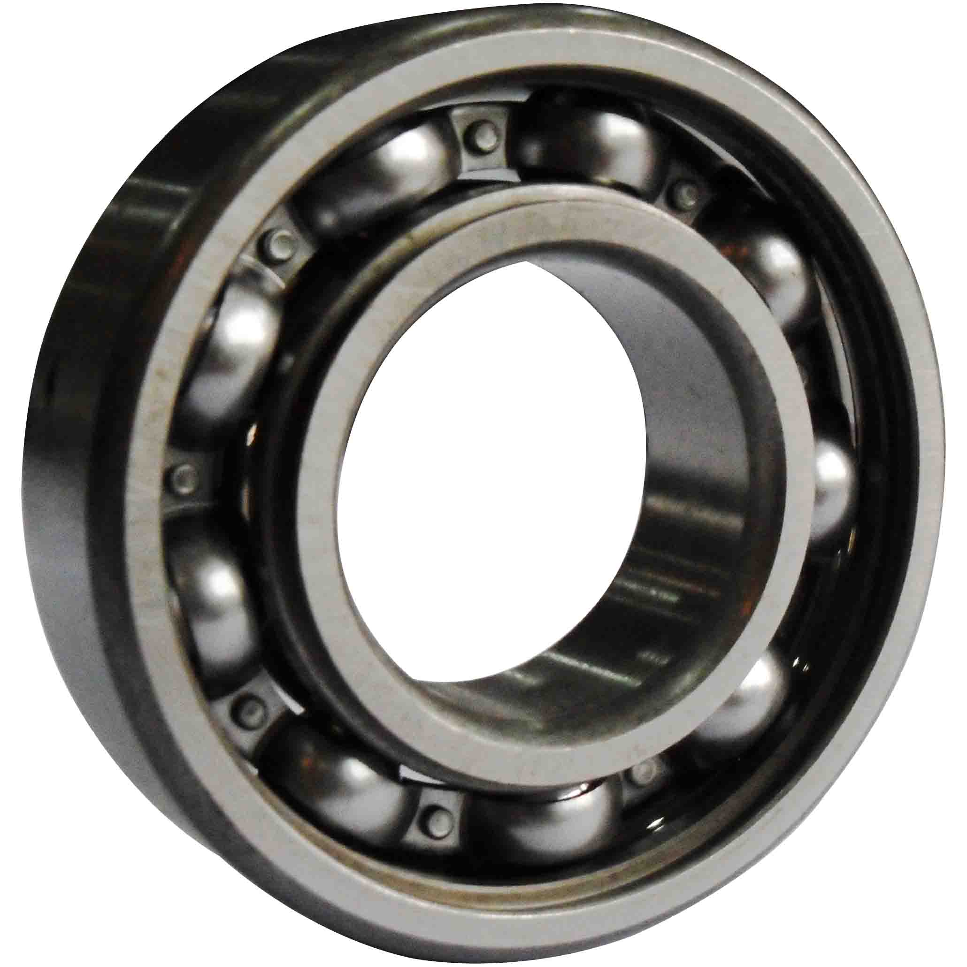
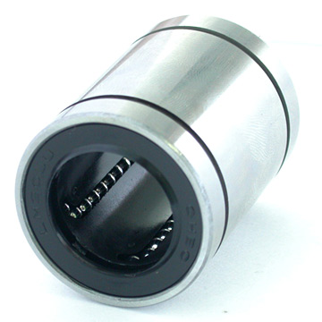
Bearing: constrains relative motion and reduces friction between moving parts to only desired motion

Slide 62
How to Build Using Mechatronics?
Understand Mechanical Aspect
Actuators
Power Transmission
Understand Electrical Aspect
Switches
Variable Resistors
Voltage Regulators
Other sensors
Understanding Digital Logic

Slide 63
How to Build Using Mechatronics?
Understand Mechanical Aspect
Actuators
Power Transmission
Understand Electrical Aspect
Switches
Variable Resistors
Voltage Regulators
Other sensors
Understanding Digital Logic

Slide 64
Electrical Aspect
Switches

Slide 65
Single Pole Single Throw (SPST)

Slide 66
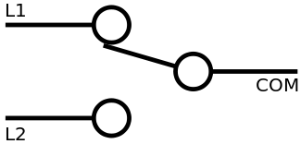
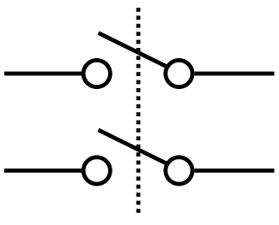
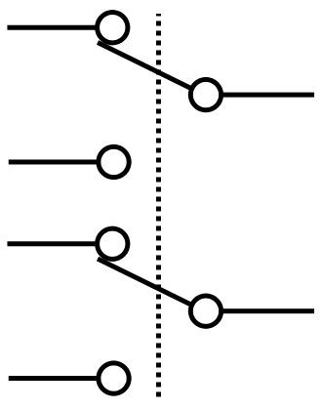
SPST
SPDT
DPST
DPDT

Slide 67
Relays

Slide 68
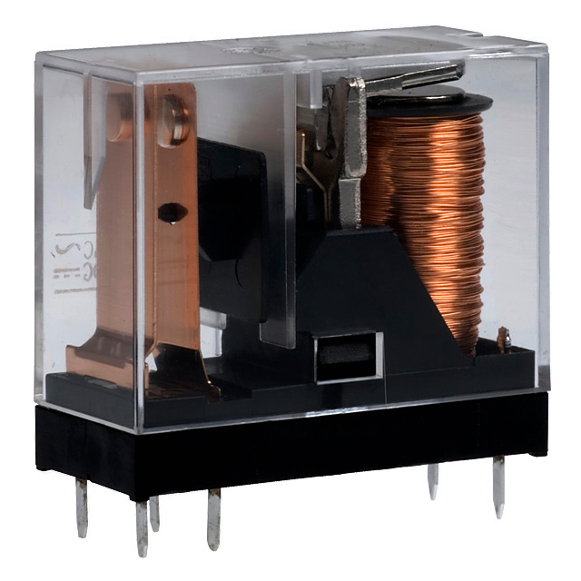
Relays
Coil Relay
Pros:
Can handle high currents
Reliable
Cons:
Cannot switch as quickly

Slide 69
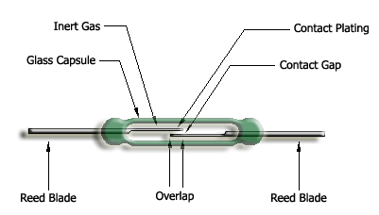
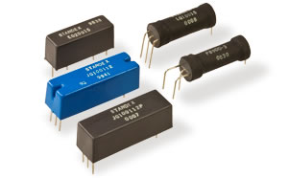
Relays
Magnetic Reed Relay
Pros:
Can switch on/off rapidly
Cons:
Cannot handle too high of currents

Slide 70
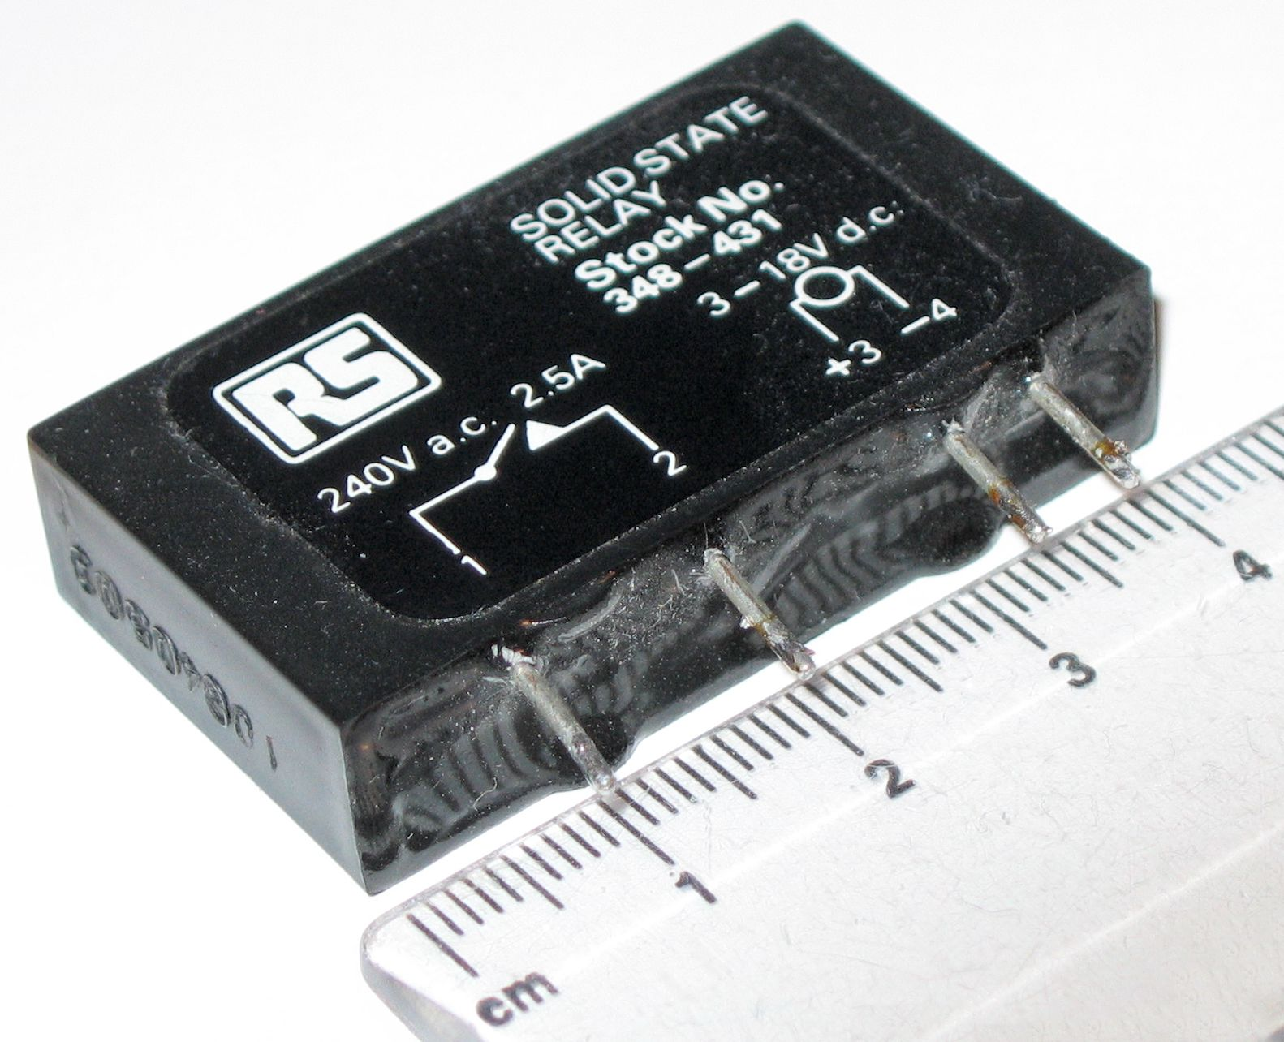
Relays
Solid State Relay
Pros:
Can switch on/off rapidly
Has wide variety of ranges for current ratings

Slide 71
Transistors

Slide 72
How to Build Using Mechatronics?
Understand Mechanical Aspect
Actuators
Power Transmission
Understand Electrical Aspect
Switches
Variable Resistors
Voltage Regulators
Other sensors
Understanding Digital Logic

Slide 73
Electrical Aspect
Variable Resistors

Slide 74
Potentiometer

Slide 75
Potentiometer

Slide 76
How to Build Using Mechatronics?
Understand Mechanical Aspect
Actuators
Power Transmission
Understand Electrical Aspect
Switches
Variable Resistors
Voltage Regulators
Other sensors
Understanding Digital Logic

Slide 77
Electrical Aspect
Voltage Regulators

Slide 78
Voltage Regulators
Linear Voltage Regulator
Pros:
Cheap
Easy to use
Cons:
Inefficient (may need heat sinking)

Slide 79
Voltage Regulators
Switching Voltage Regulator
Pros:
Efficiency
Cons:
Extra cost

Slide 80
How to Build Using Mechatronics?
Understand Mechanical Aspect
Actuators
Power Transmission
Understand Electrical Aspect
Switches
Variable Resistors
Voltage Regulators
Other sensors
Understanding Digital Logic

Slide 81
Electrical Aspect
Other sensors

Slide 82
Photoresistors

Slide 83
Infrared Proximity Sensor

Slide 84
Ultrasonic Distance Sensor

Slide 85
Flex Sensor

Slide 86
Hall Effect Sensor

