Slide 1
What is Trichotillomania?
Notes:
Linda
You may have heard someone casually exclaim, “I’m so stressed, I’m going to pull my hair out.” But while they may say this without actually intending to pull their hair, there are about 2.5 million people in the US who live with a hair-pulling disorder in which they can’t stop themselves from pulling their hair. This condition is called trichotillomania.

Slide 2
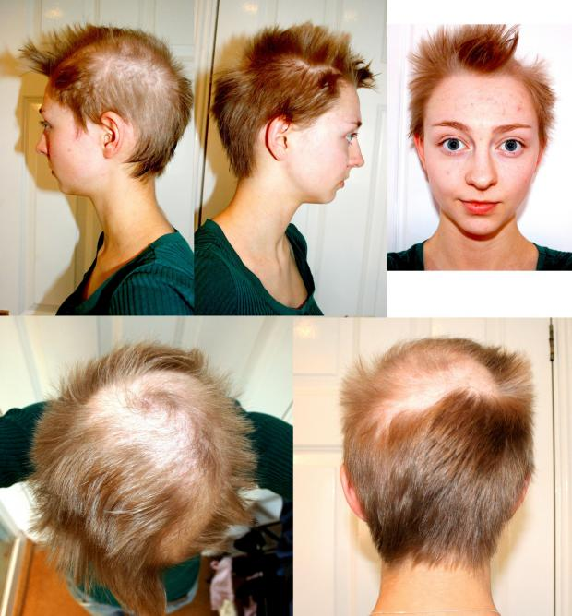
Trichotillomania (TTM)
Hair pulling disorder
Impulse control disorder
Common sites
Scalp
Eyebrows
Arms
Pubic region
Anxiety and depression
Notes:
Linda
Trichotillomania, or TTM, is a hair pulling disorder that is categorized as an impulse control disorder. The girl shown here on the right is Rebecca Brown from the TTM documentary, Trichster. In it, she describes how can’t stop herself from pulling her hair, even when she’s aware that she’s doing it. The most common site that people with TTM pull from is the scalp; however, they also pull from the eyebrows, arms, and pubic region. Individuals with TTM, like Rebecca, often suffer from anxiety and depression due to their hair loss, which usually leads to a lack of engagement in social settings.

Slide 3
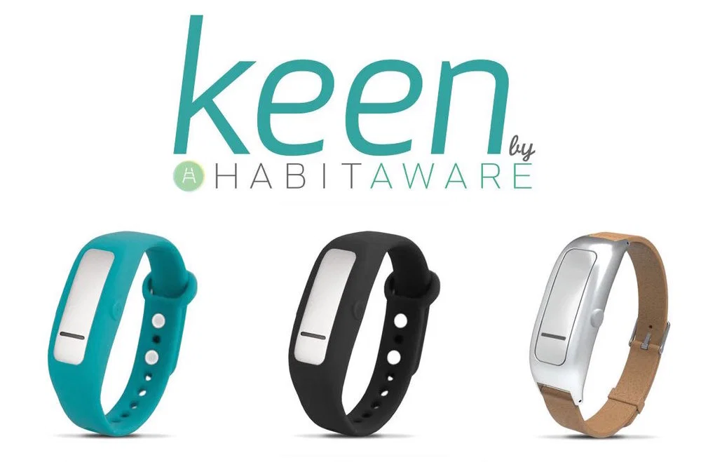
Existing TTM Solutions
Smart Wearables (such as Keen)
Detect when arm is being raised
Many false positives
Works only for specific positions
Online Therapy (such as Trichstop)
Therapy with Experts
Expensive
Slow Process
https://habitaware.com/pages/how-it-works
https://www.trichstop.com/
Notes:
Linda
Current solutions for individuals with TTM include the Keen habitaware and Trichstop. The Keen is a form of smart wearable that detects when the arm is raised to pull hair. However, there are many false positives with this device, meaning it signals a hair pull when one hasn’t occurred, and the device only works when the arm is in specific positions relative to the body. Trichstop, on the other hand, is an online therapy resource that allows individuals with TTM to attend therapy sessions with trained specialists. The therapy process, however, is often expensive and can be slow process to combat TTM.

Slide 4
TRICH or Treat
Zach Alvear, Joshua Bae, Anirudh Kuchibhatla, Linda Liu, Fredy Martinez, Saideep Narendrula, Jack Wilson, Thomas Zhang
Notes:
Linda
The shortcomings of current solutions is what our team aims to bridge. We are Team TRICH or Treat and our mission is to develop a device for individuals with trichotillomania that provides better detection accuracy than currently existing devices, helps individuals monitor their behavior, and overcome their hair pulling disorder.

Slide 5
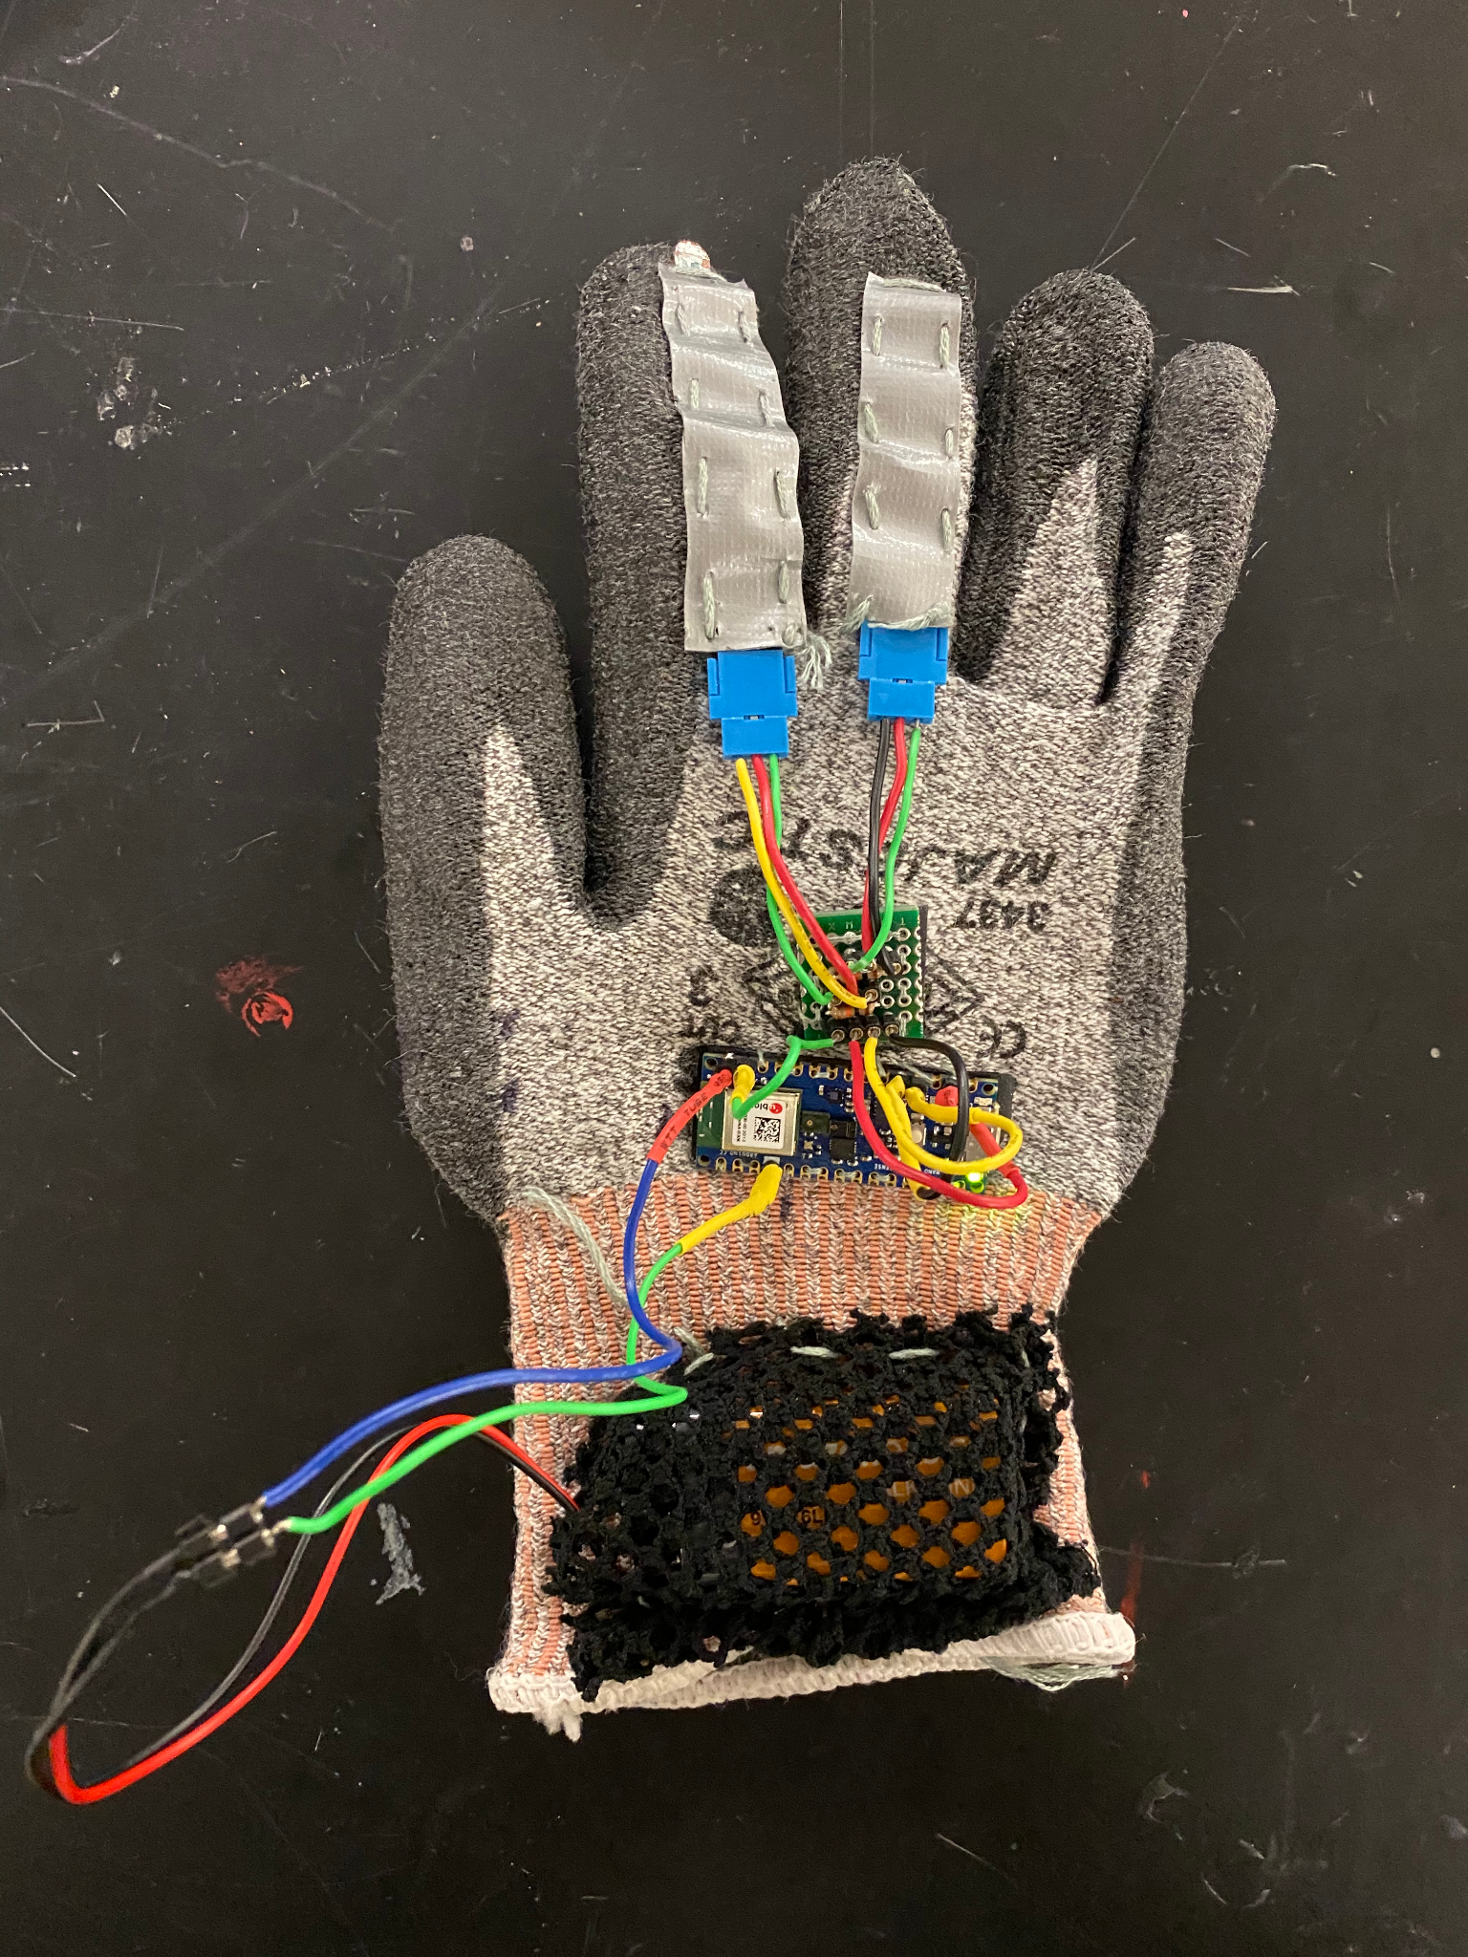
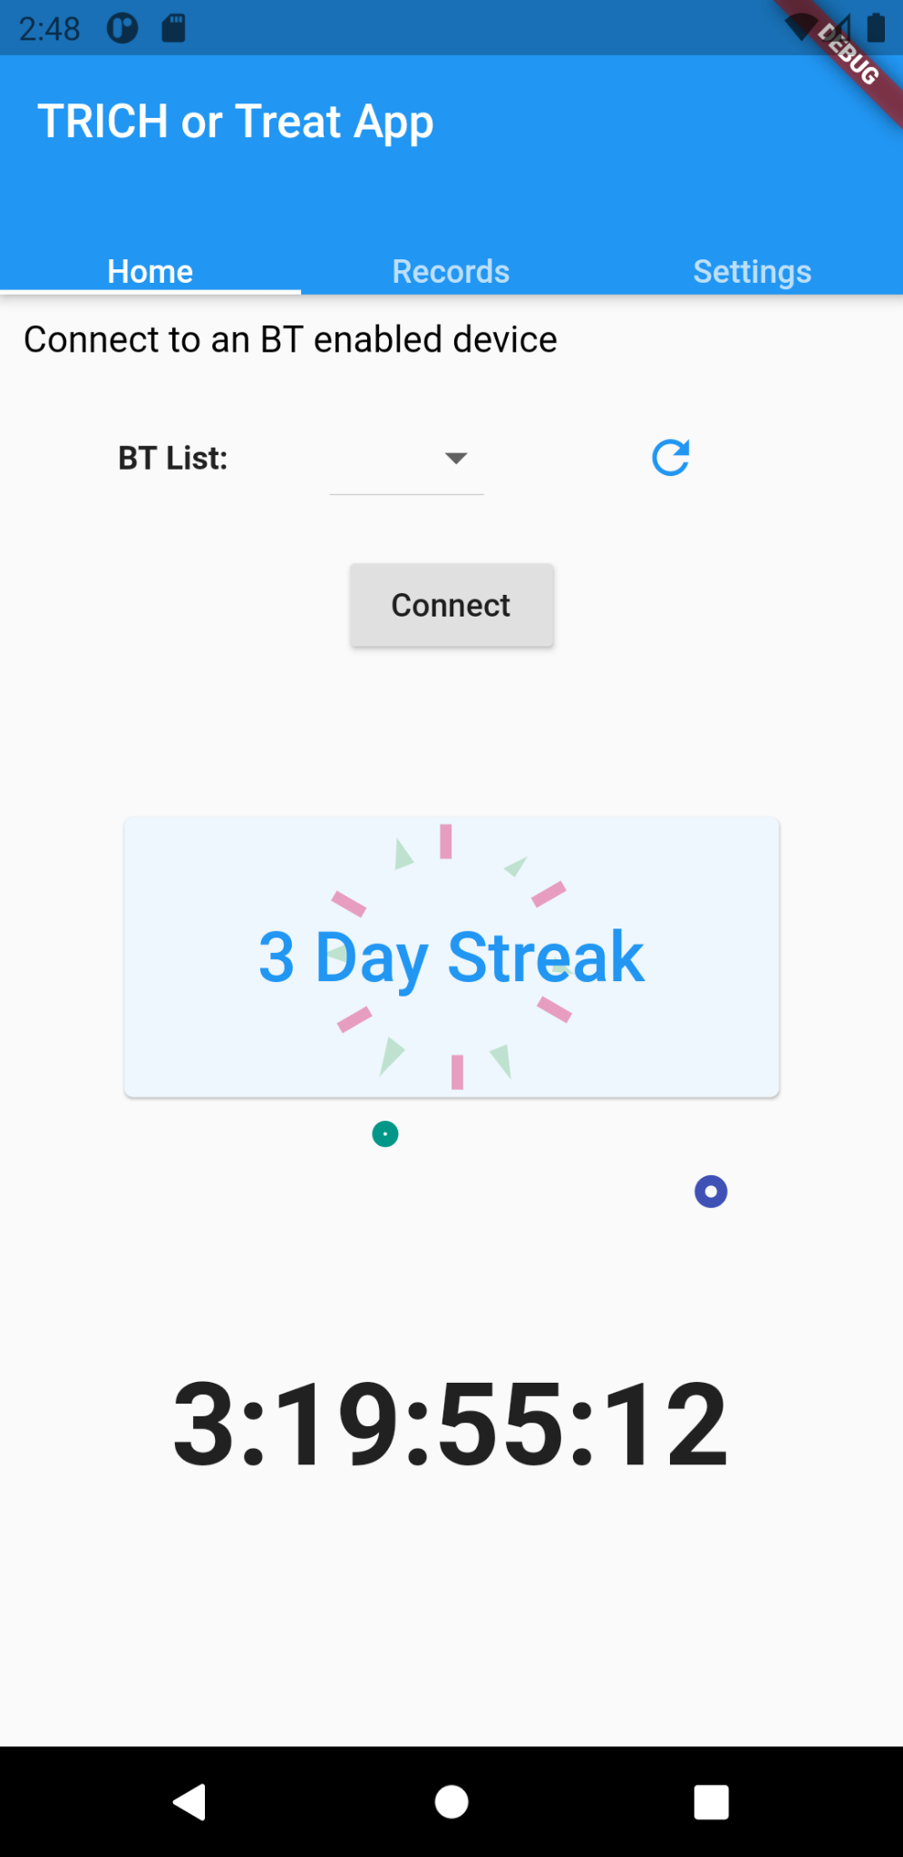
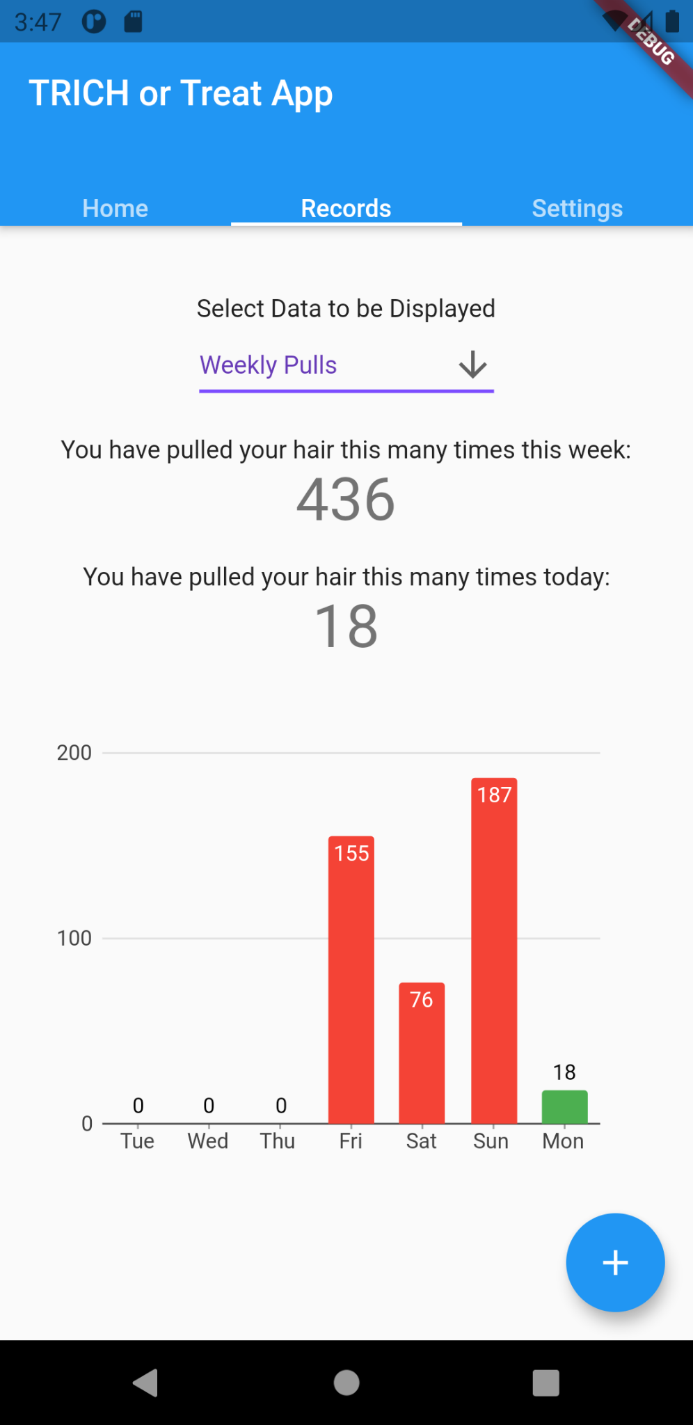
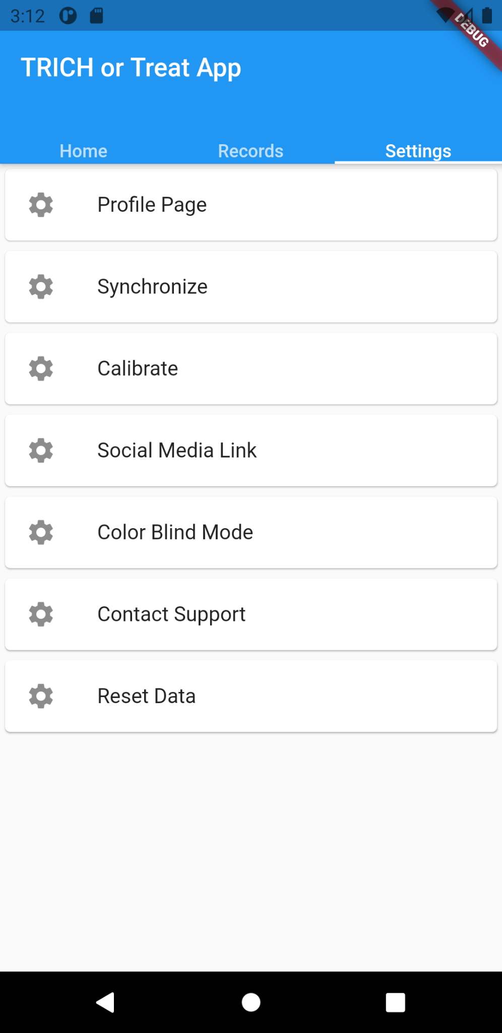
Our Solution
Glove wearable
Mobile application
Detects hair pulling motion and communicates with app to alert users
Alerts users of hair pulls that it detects and tracks the frequency of pulls
Notes:
Josh
Our solution is a two-component system that consists of a glove wearable and a smartphone app. The glove wearable collects and interprets the data from the sensors and uses a machine learning detection algorithm to determine whether a hair-pull has occurred. The smartphone app component of this device provides an interactive interface for the user to track their hair-pulling behavior.

Slide 6
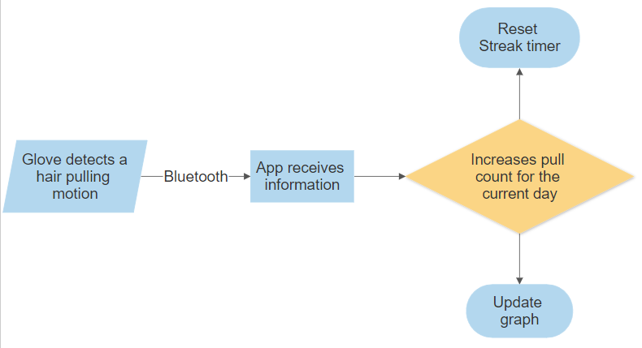
How Our System Works
Notes:
Josh
As shown in this flow diagram, the glove will detect the hair pulling motion and will send a signal via Bluetooth to the smartphone app. The app will increase a pull count when it receives the trigger and will reset the no-pull streak timer and update the graph to show the user their recent hair pulls.

Slide 7
Glove Prototype
Glove
Flex Sensors
Protoboard
Arduino Nano
Battery Pack
Notes:
The glove prototype is made up of the following components: peripheral flex sensors to monitor the bend of the fingers, an Arduino Nano with an on-board gyroscope and accelerometer for measurements, a durable poly/cotton glove for continuous wear, a protoboard for wired connections to the Arduino, and a battery pack to power the device

Slide 8
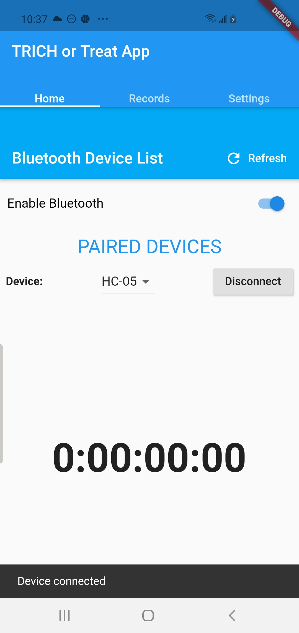
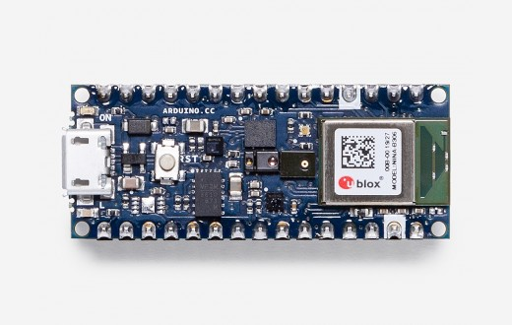
Bluetooth Compatibility
Arduino Nano BLE 33 Sense
Home Tab of Smartphone App
Notes:
Affixed to our wearable, our microcontroller of choice, the Arduino Nano BLE 33 Sense has Bluetooth Low Energy capabilities that make continuous data transmission very efficient. The device enables the app and wearable to work seamlessly to register and record every hair-pull signal from the arduino to a connected smartphone.
The Bluetooth pairing process is very simple and intuitive. A user simply enables the bluetooth function on their smartphones and clicks on the drop down menu to pair to the corresponding glove. Upon pairing, the app begins reading hair pulls and updates the app in real-time.

Slide 9
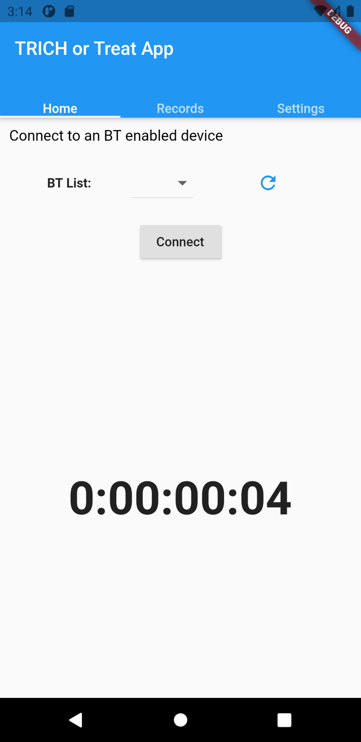
No-Pull-Streak Timer
Notes:
Jack
Now moving on to talk more specifically about the application UI. Shown in the pictures, the first aspect of pull tracking we have incorporated is a timer that displays the no pull streak. Once the user surpasses one full day of not pulling, their streak will be displayed on screen and they will have access to the reward system where they can tap on the day streak and see a colorful display. If the device detects a pull, the timer will be reset back to zero and the day streak will disappear.

Slide 10
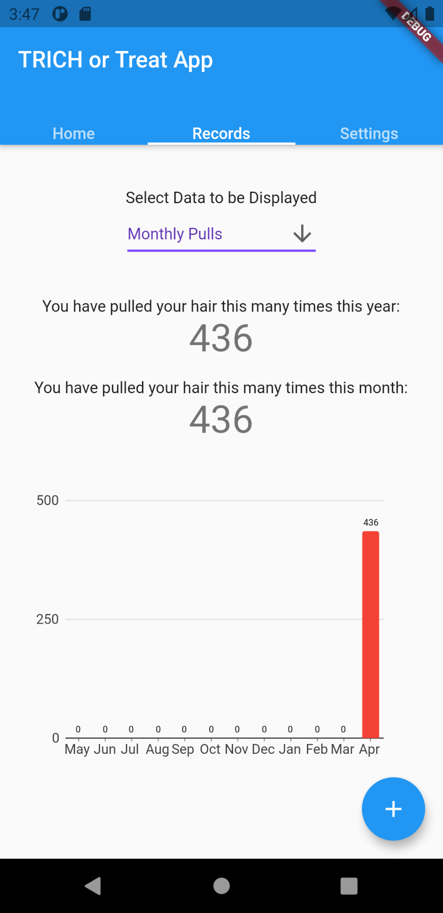
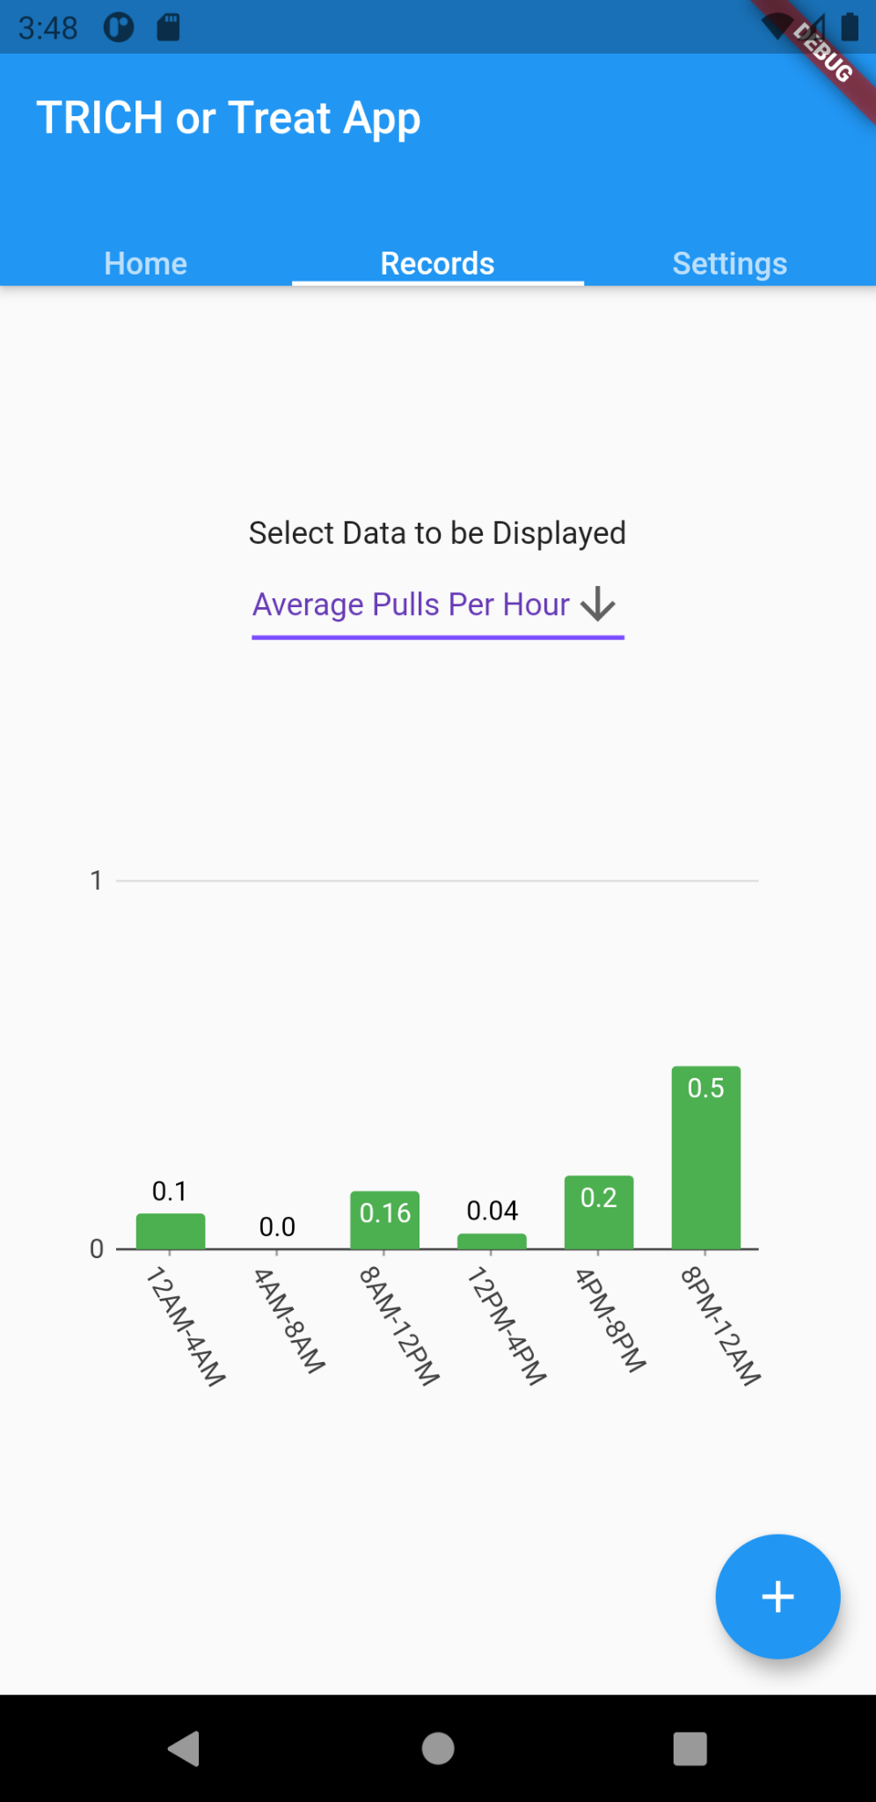
Number of Pulls Detected
Notes:
Jack
Along with the timer, the app also displays the number of pulls the device has detected - either on a weekly basis (shown on the left) or monthly basis (shown in the middle) depending on how the user wants to view the data. The colors on the graph have different meanings with red showing high pull days, yellow (not pictured) showing medium pull days and green showing low pull days. Additionally, the user can also see their average number of pulls at certain times throughout the day (shown on the right). This one is likely the most important display as the user can use this data to know when they have to be the most cognizant of their pulling and hopefully prevent it more in the future.

Slide 11
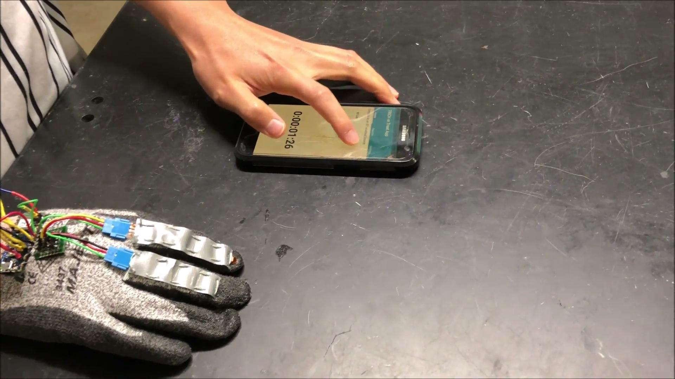
Device Demonstration
Notes:
In this video, our user Josh demonstrates using our wearable and app solution. He begins by connecting the battery to begin powering the device and launching the mobile app on his phone. In a real-world use case, the user will need to recharge the battery to ensure that it continuously reads values for extended periods of time.
Josh now starts the pairing process with the app by refreshing the lists of BT devices available and finding the wearable titled “TrichMonitor.” Once he presses connect, the detection algorithm begins looking for hair pulls. At the bottom of this home page, there is also a running timer that resets with every hair pull; users will be able to track exactly when they last pulled their hair.
We see on the graph here that Josh has already recorded 2 pulls for the day. He now demonstrates another hair pull which will then increment the pull counter for the day and update the corresponding graphs to reflect these results. And we do see updated on the app, the pull has been successfully recorded for the user to see.

Slide 12
TRICH or Treat TTM Device
Glove wearable
Mobile application
Notes:
Linda
We believe our TTM behavior detection solution will provide better hair pulling detection than currently existing TTM solutions and a better mobile application that users can interact with to monitor and reduce their hair pulling disorder. We hope that potentially users of our device, such as Rebecca Brown from the beginning of this presentation, will feel in more control of their behavior and may one day, overcome their trichotillomania.

Slide 13
Acknowledgements
Dr. Sabia Abidi
Dr. Gary Woods
Ms. Alondra Escobar
Dr. Eric Storch
This project is sponsored by the OEDK. The design work for this project is supported by the resources of the Oshman Engineering Design Kitchen.
Notes:
Faculty mentors
Design mentor
Client sponsor

Slide 14
Questions?
Notes:
Linda
We will now open up the floor to questions. Thank you
STOP SCREEN SHARING

Slide 15
Supplemental Slides

Slide 16
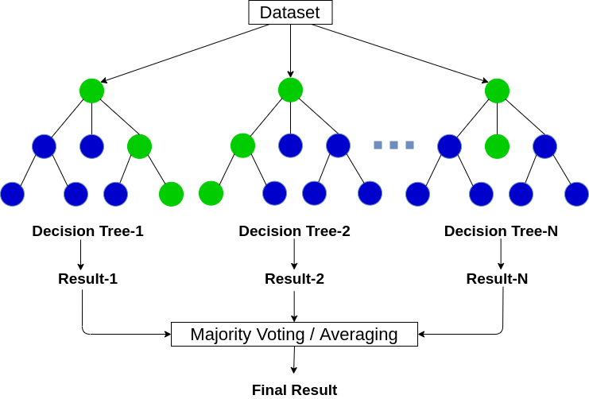
Detection Algorithm
Random Forest
Ensemble machine learning
Training on real/fake pulling motions
8 Features:
Flex resistances (Ω)
Acceleration (g’s)
Rotation (degrees/second)
Random Forest Classifier

Slide 17
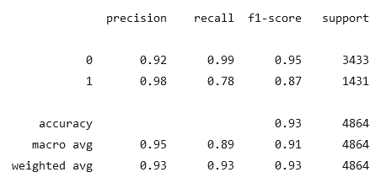
Random Forest Scoring Metrics

Slide 18
Circuit Schematics

Slide 19
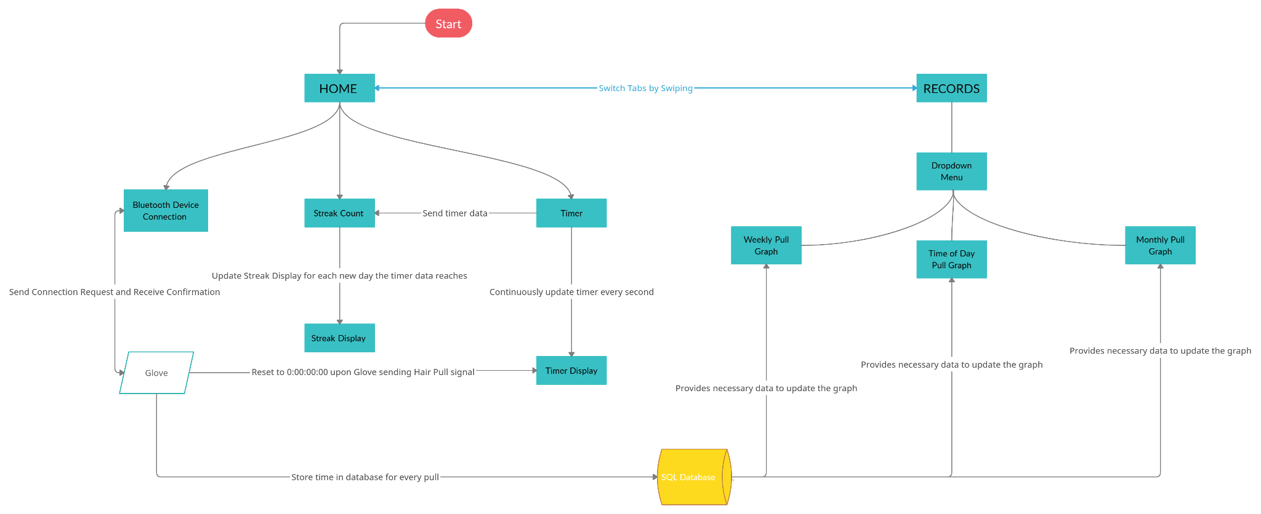
App Diagram

Slide 20
Device Testing Motions
True Motion 1: Have the user standing. Raise gloved hand from waist to head. Place the gloved hand within 1-5 mm of hair. Attempt to pinch 1-4 pieces of hair and pull the hand away in a horizontal motion.
True Motion 2: Have the user sitting down on a stool. Raise gloved hand from chest level to head level. Place the gloved hand within 1-5 mm of hair. Attempt to pinch 1-4 pieces of hair and pull the hand away in a vertical/horizontal motion.
False Motion 1: Have the user sitting on a stool. Raise gloved hand from waist-level to head. Place the hand near the neck and pinch skin lightly with the index finger and thumb.
False Motion 2: Have the user sitting down. Raise the gloved hand from the waist to the head level. Make the gloved hand with all fingers and the palm in the same plane. Move the gloved hand through the hair and observe results.
Notes:
True Motion 1
This motion is meant to emulate the standard hair pulling motion from a standing user.
True Motion 2
This motion is meant to emulate the hair pulling motion when sitting. With the Habitaware Keen, this often lead to false positives as soon as the hand was raised

